Slide 1
Subjects’ Traces alignment
August 2024
Andrea Corrado

Slide 2
Outline
Corrections on previous declaration on data
Understanding signals and their nature.
Necessity of alignment
QRS detection: Pam-Tompinks algorithm
Traces alignment: strategy 1
Description
Results
Traces alignment: strategy 2
Description
Results
Conclusions

Slide 3
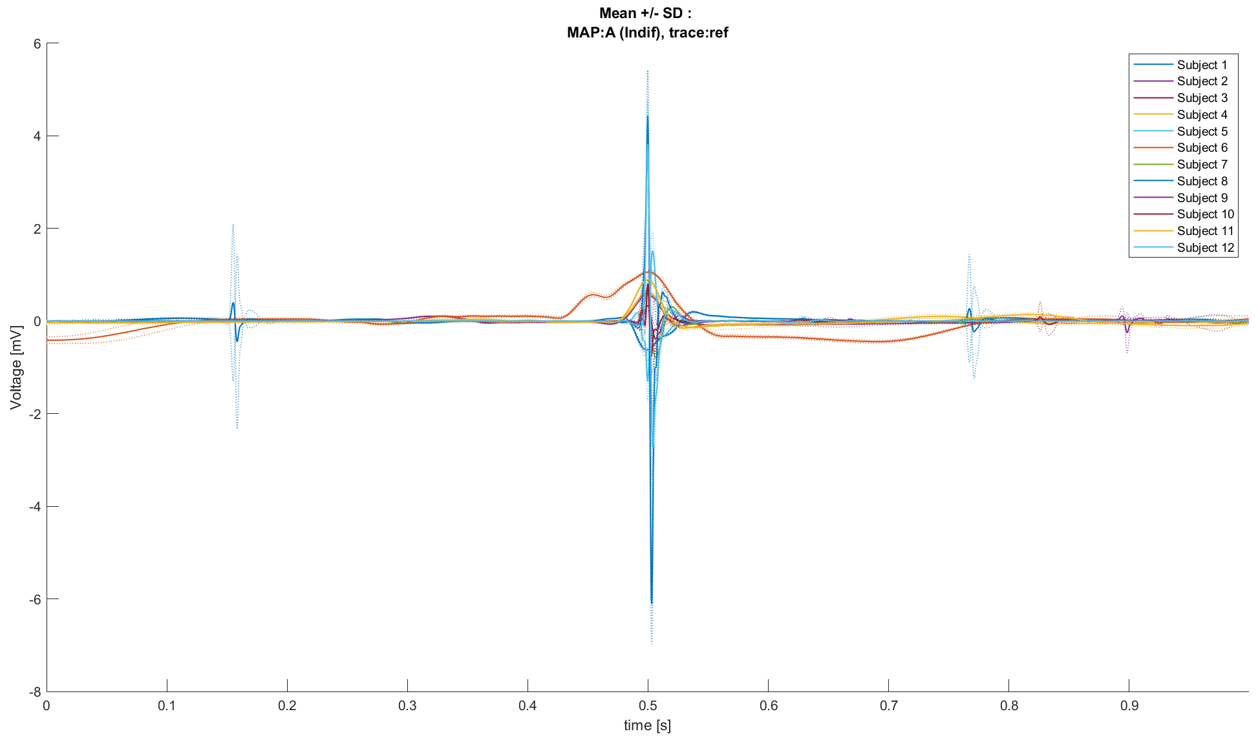
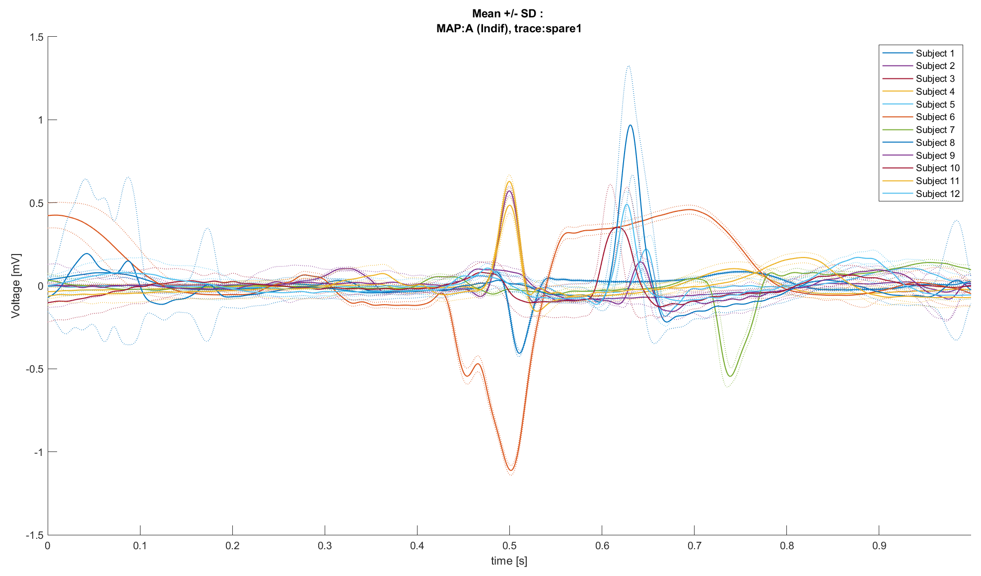
Spare1 trace ≠ Reference trace
So far, we trusted that the reference trace and the spare1 trace were composed by the same signals. But:
Reference
Spare1
Mean ± SD plots (same Map, different subjects)
Into each MAP, reference and spare1 trace aren’t the same, except for subjects 2 and 4.
Such observation support the option that spare traces have a different nature from reference ones
Knowing the true nature of these signals now becomes crucial.

Slide 4
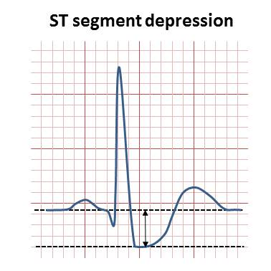
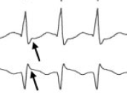
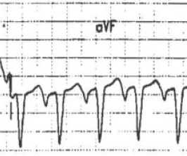
Understanding signals and their nature
It is now necessary to know satisfactorily the true nature of the signals in the dataset, and for this a literature search was conducted.
What are the characteristics of ECG signals in the case of AVNRT? [1,2]
QRS complexes duration below 120ms (and heart rate >100 bpm)
Possible ST depression (even associated with tachycardia)
Main aspect for the diagnosis of AVNRT: abnormalities of the P wave
Could be masked by the QRS (slow-fast AVNRT)
Could be negative (fast-slow and slow-slow AVNRT)
aVF
V1
1. Katritsis, D. G., & Camm, A. J. (2010). Atrioventricular nodal reentrant tachycardia. Circulation, 122(8), 831-840.
2. Hafeez Y, Armstrong TJ. Atrioventricular Nodal Reentry Tachycardia. 2023 Aug 7. In: StatPearls [Internet]. Treasure Island (FL): StatPearls Publishing; 2024 Jan

Slide 5
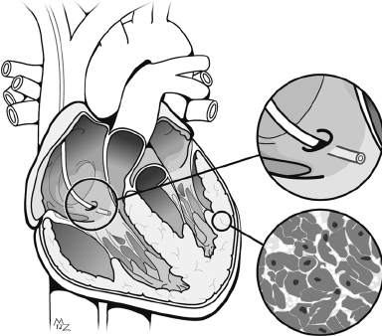
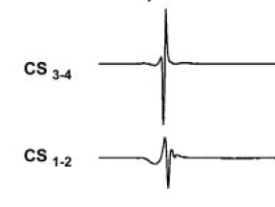
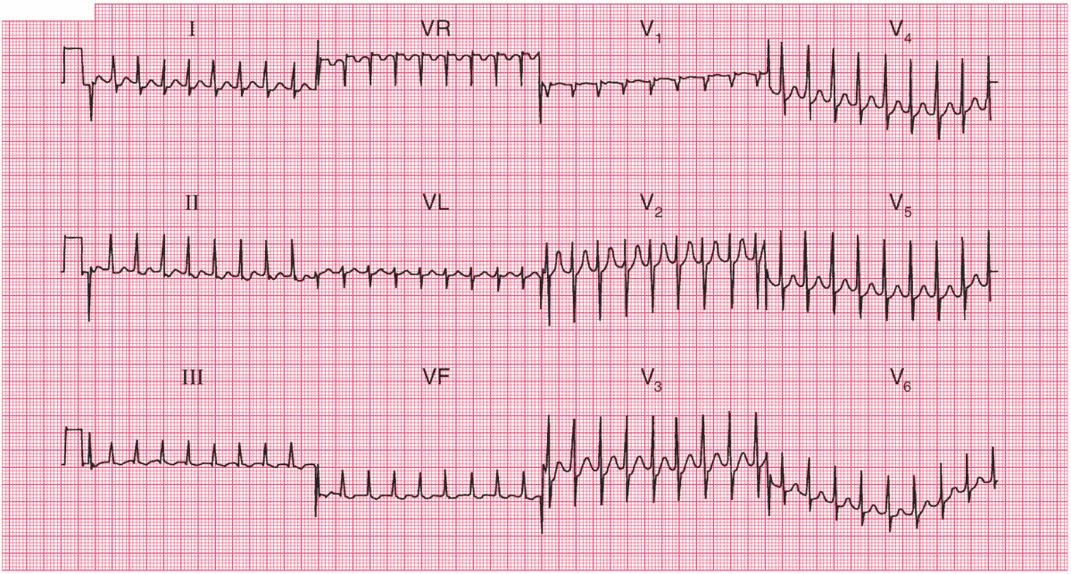
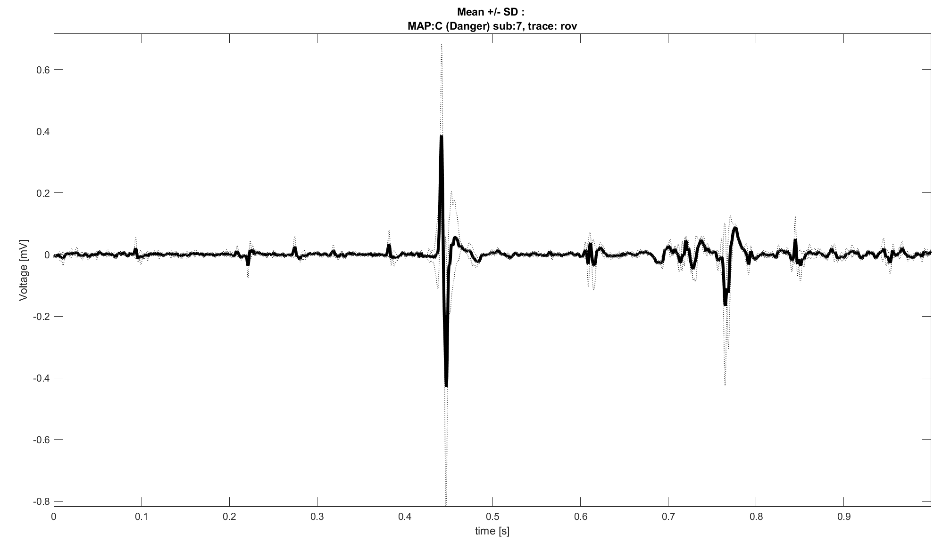
Understanding signals and their nature
Which are the ECG signals recorded during AVNRT ablation procedure? [1,2,4]
12 leads ECG
Mapping electrode signals (Rov trace signals)
Coronary Sinus (CS) signal
Measure directly the Atrial Activity
It’s not always used, but it’s recommended
4. Budzikowski, Adam S., et al. "How to perform cryoablation for atrioventricular nodal reentrant tachycardia." Cardiology Journal 14.6 (2007): 597-604.

Slide 6
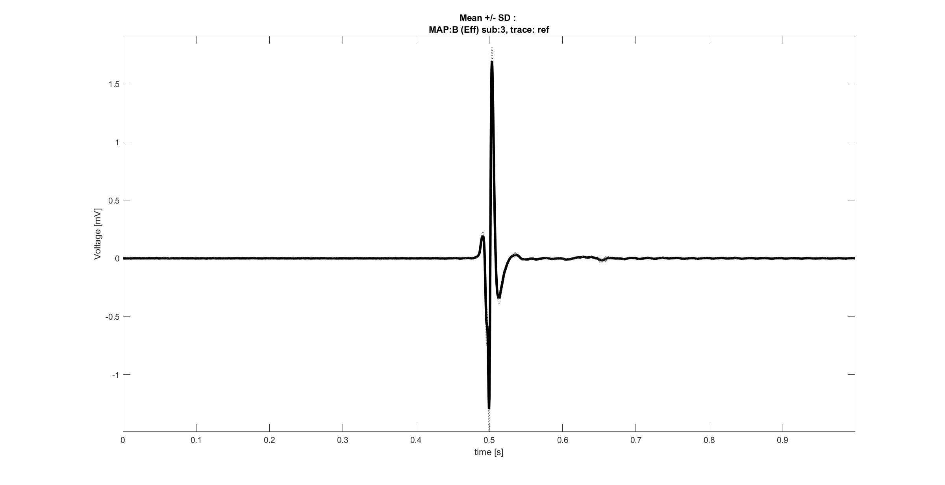
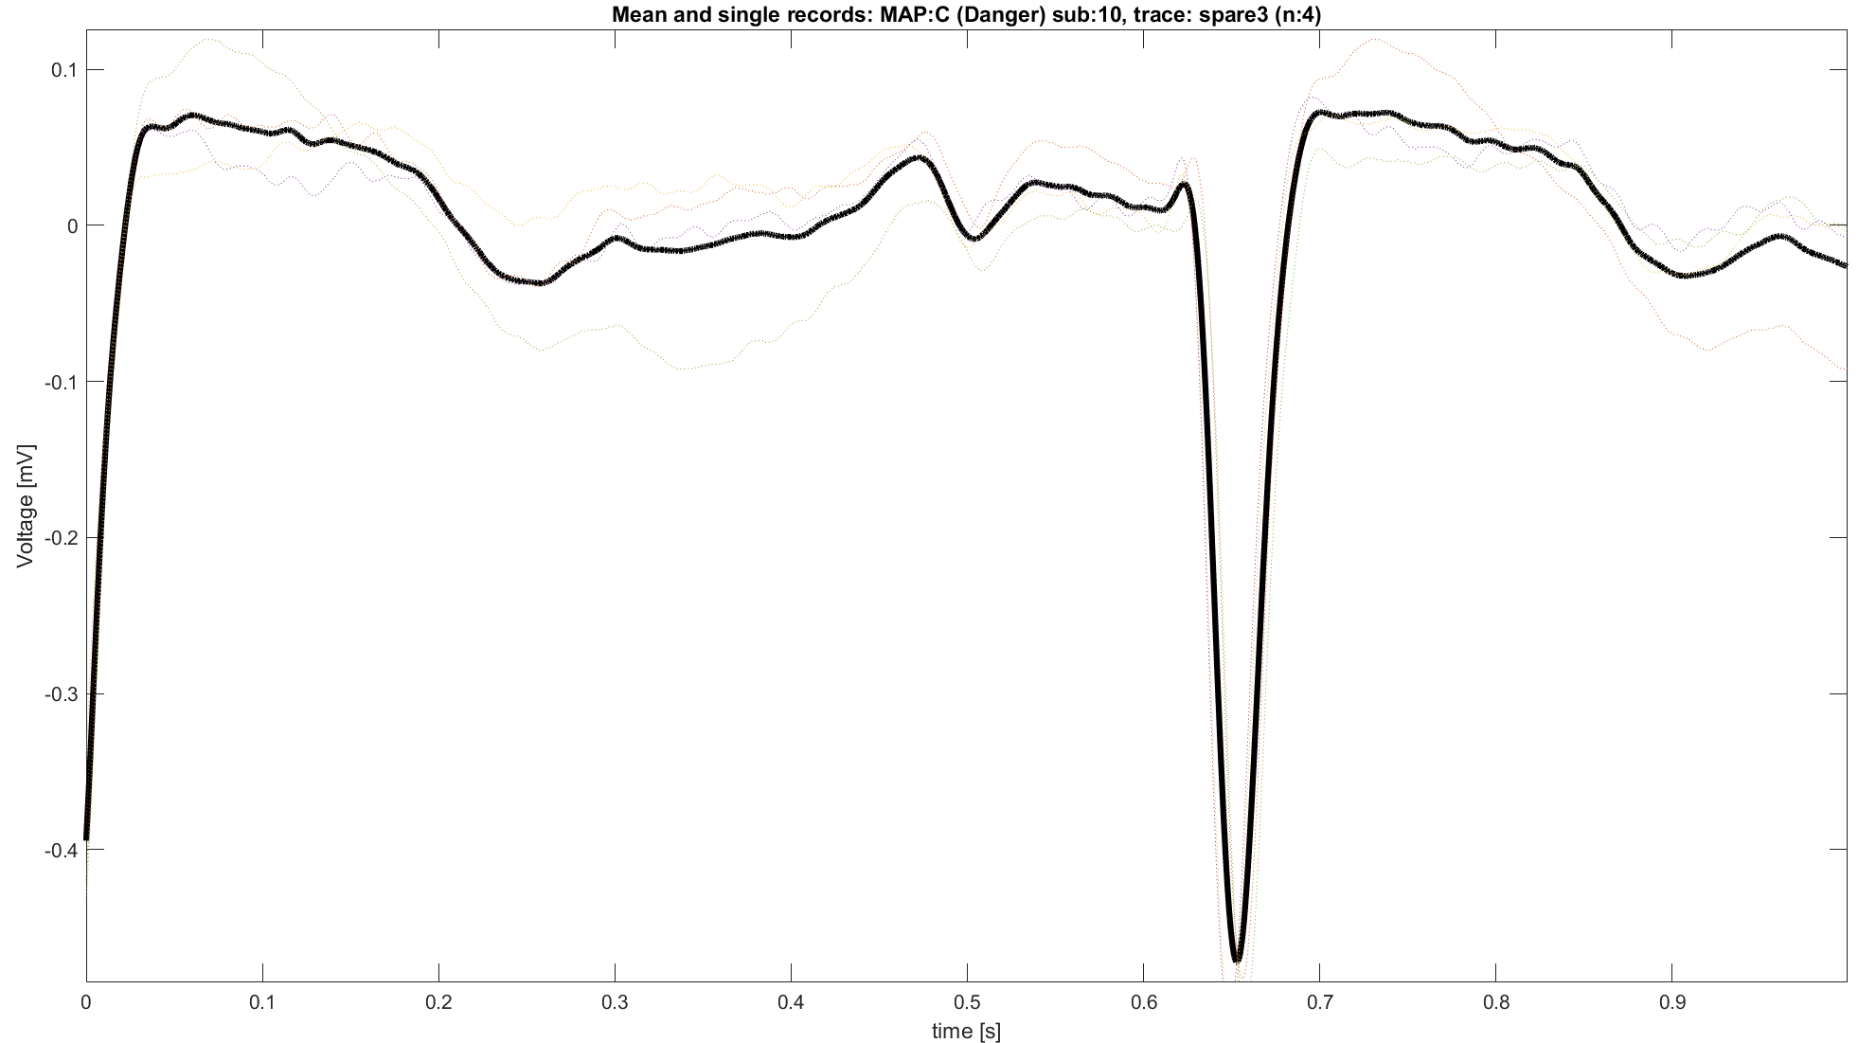
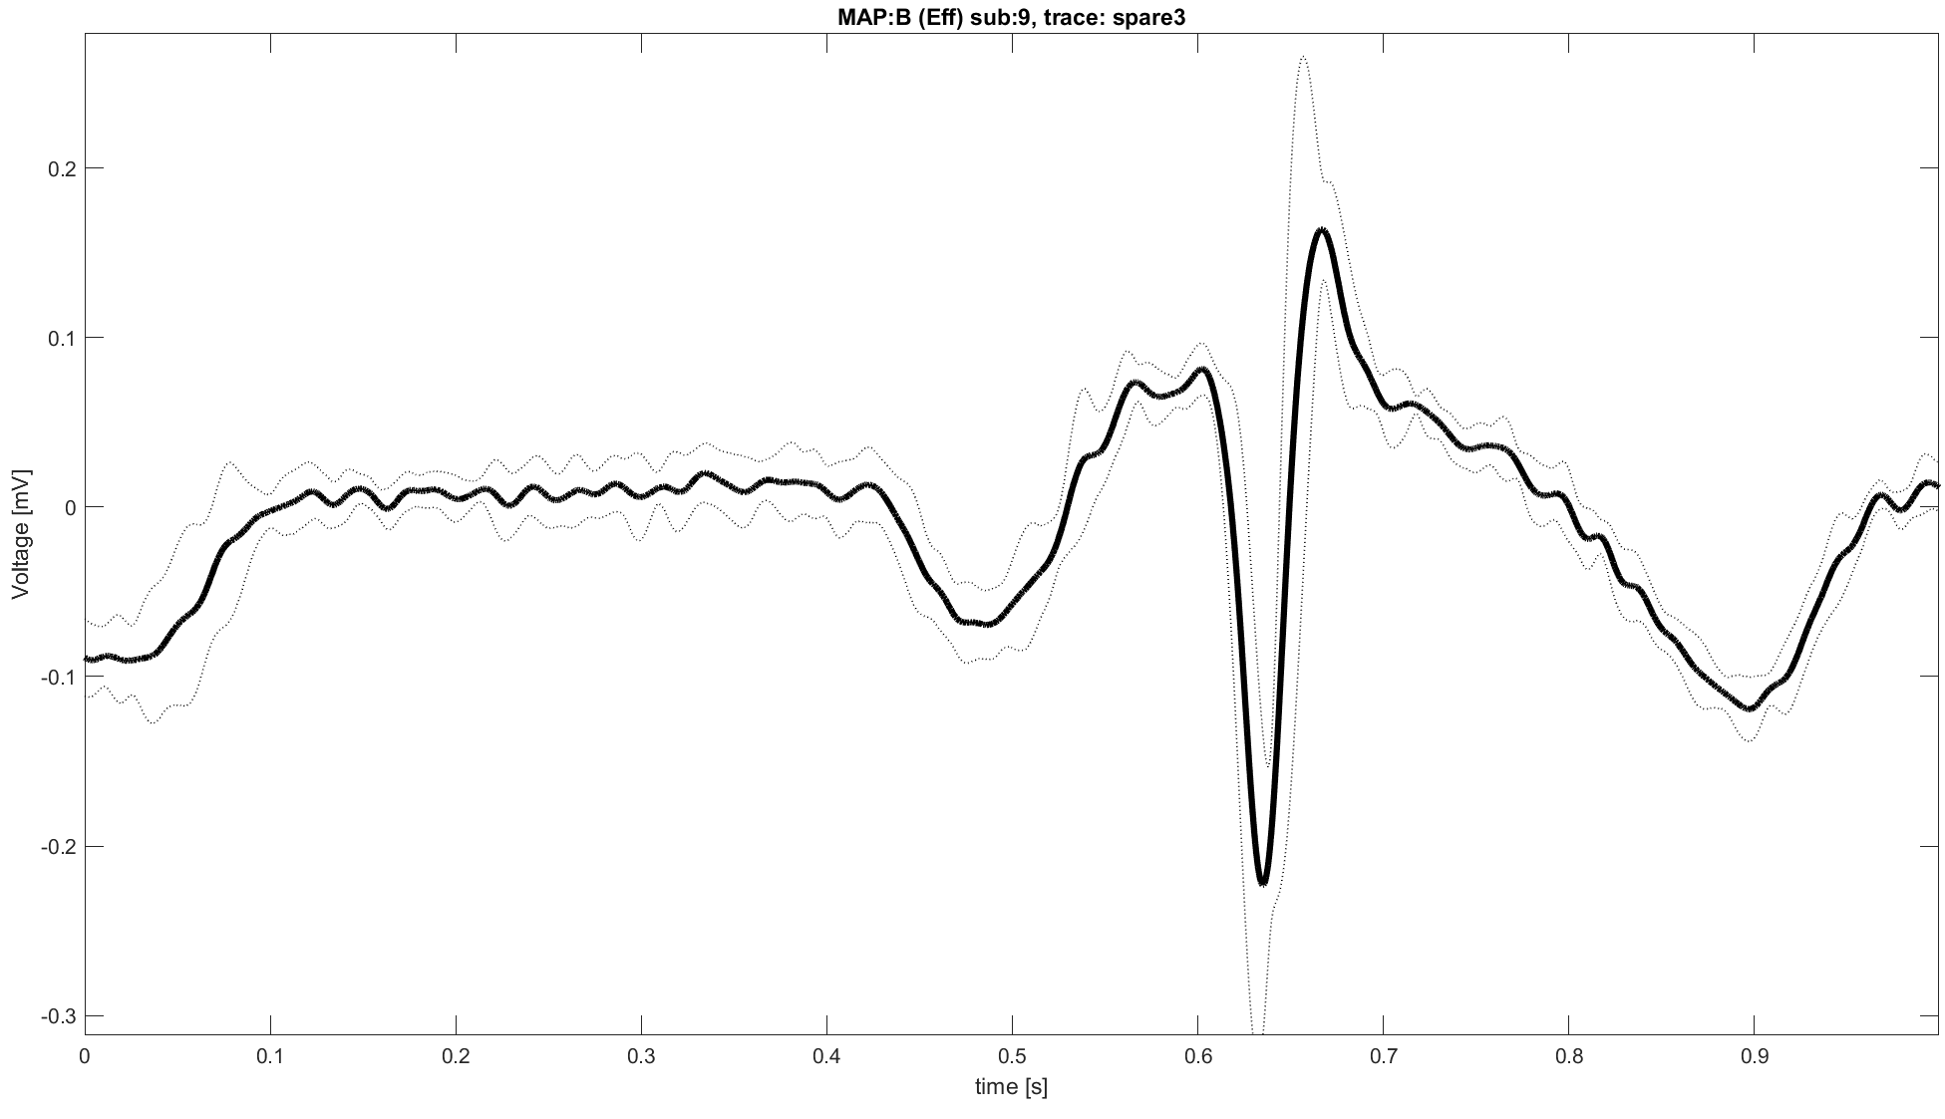
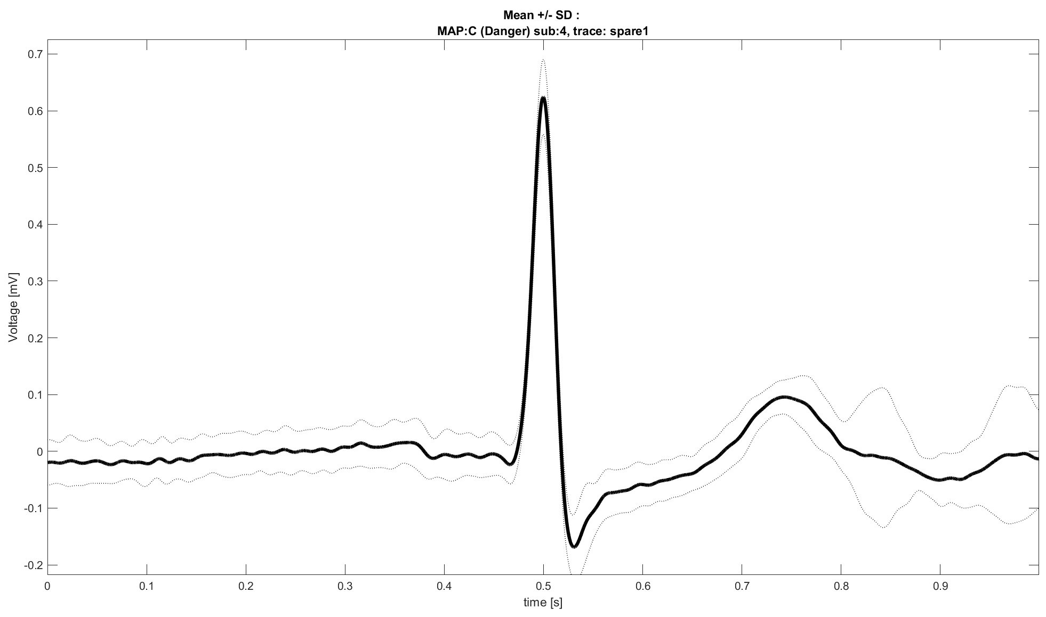
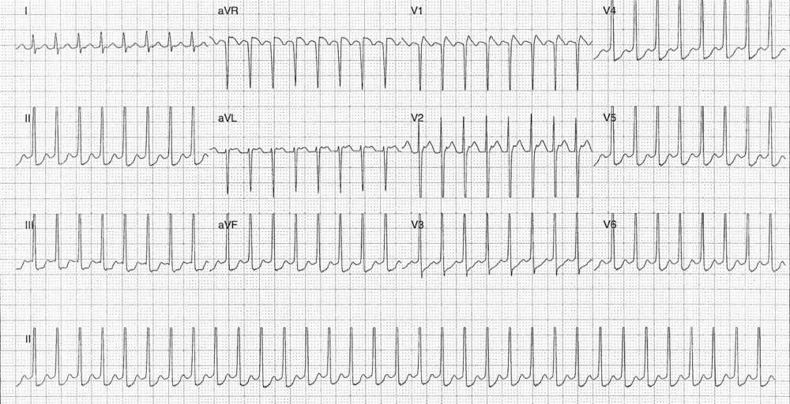
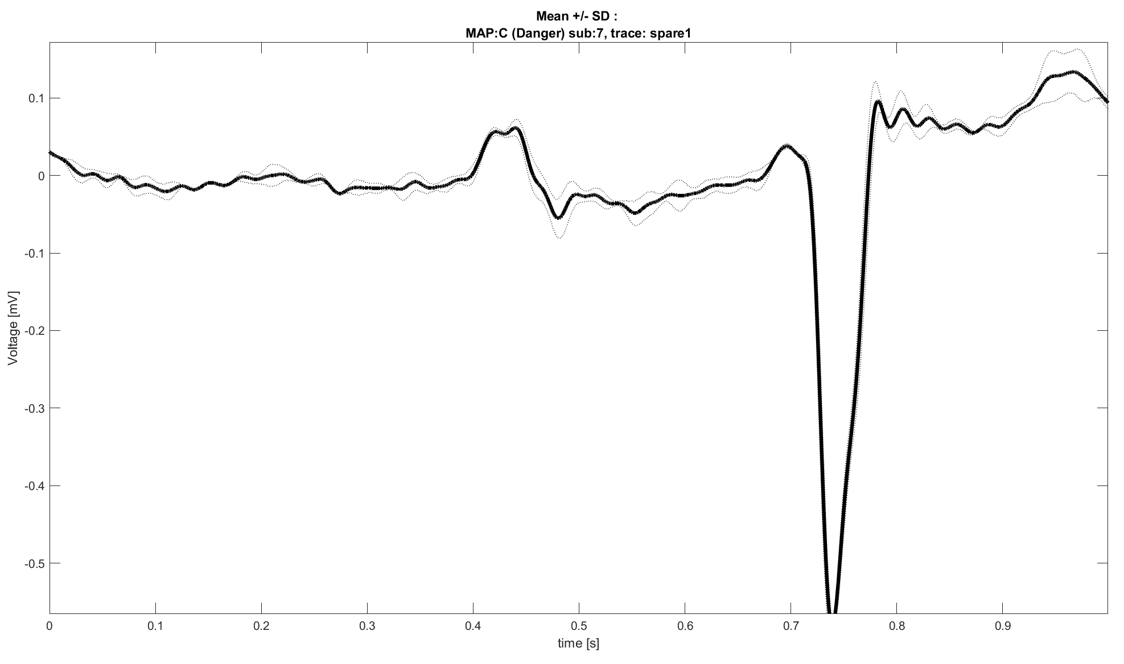
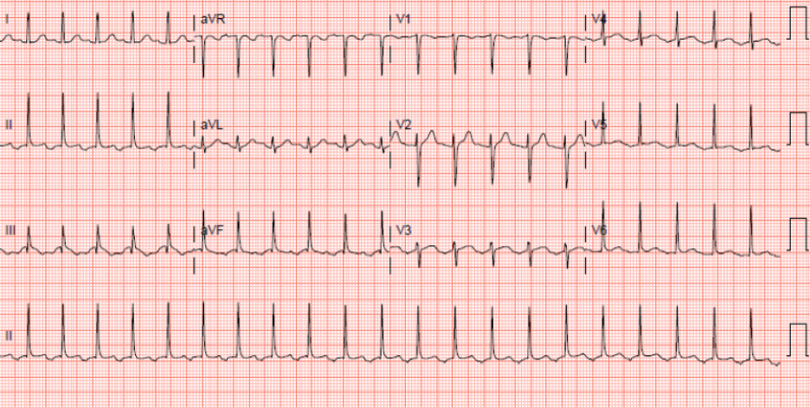
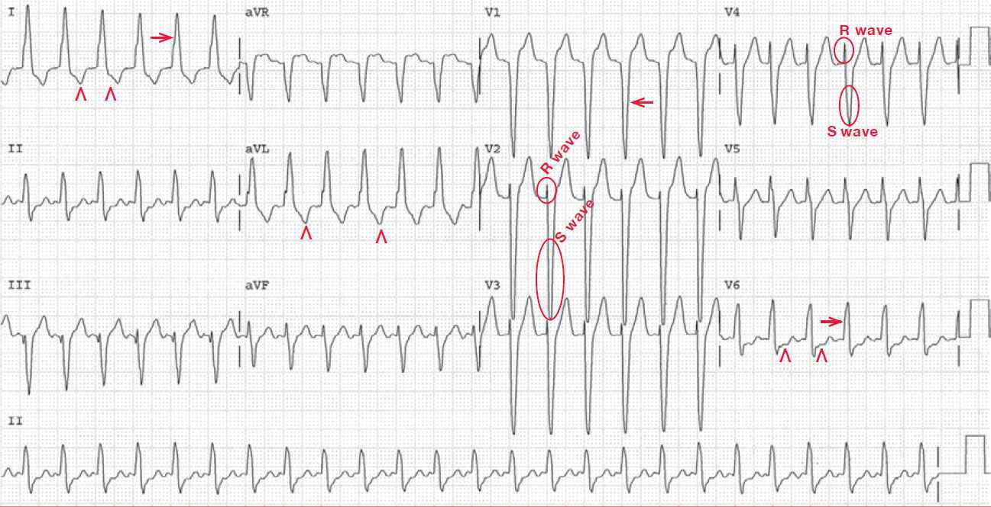
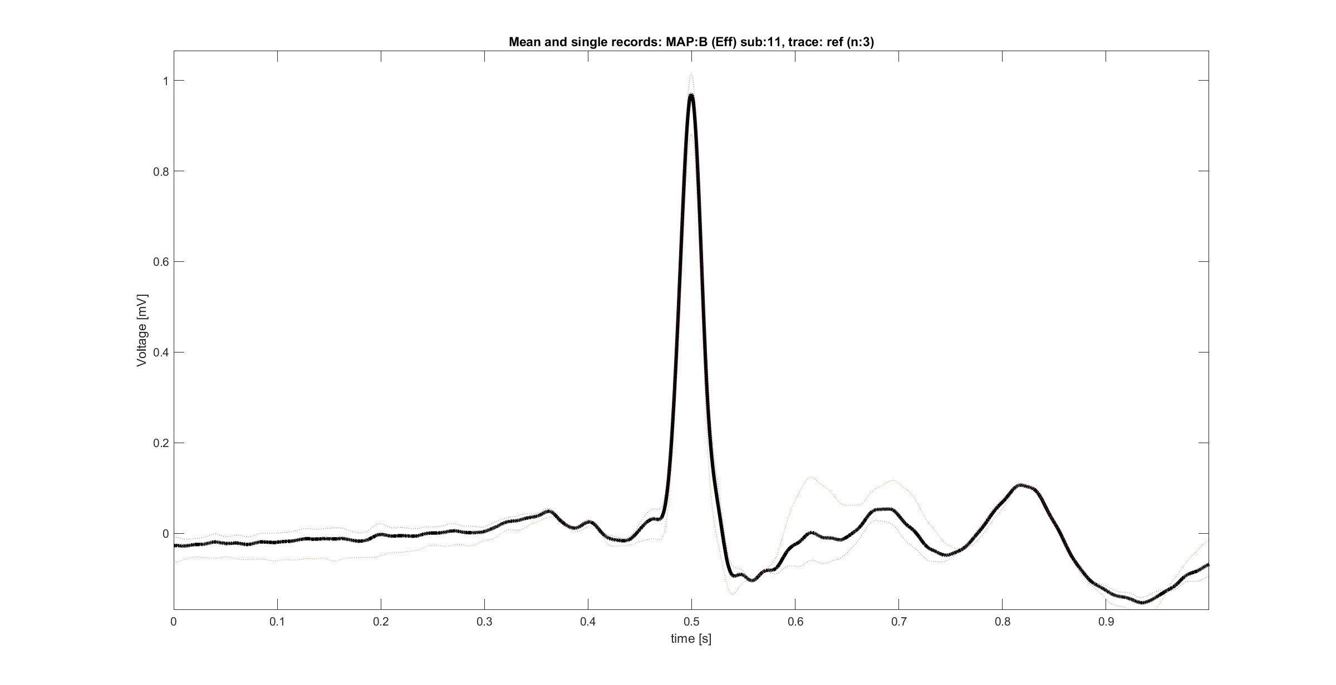
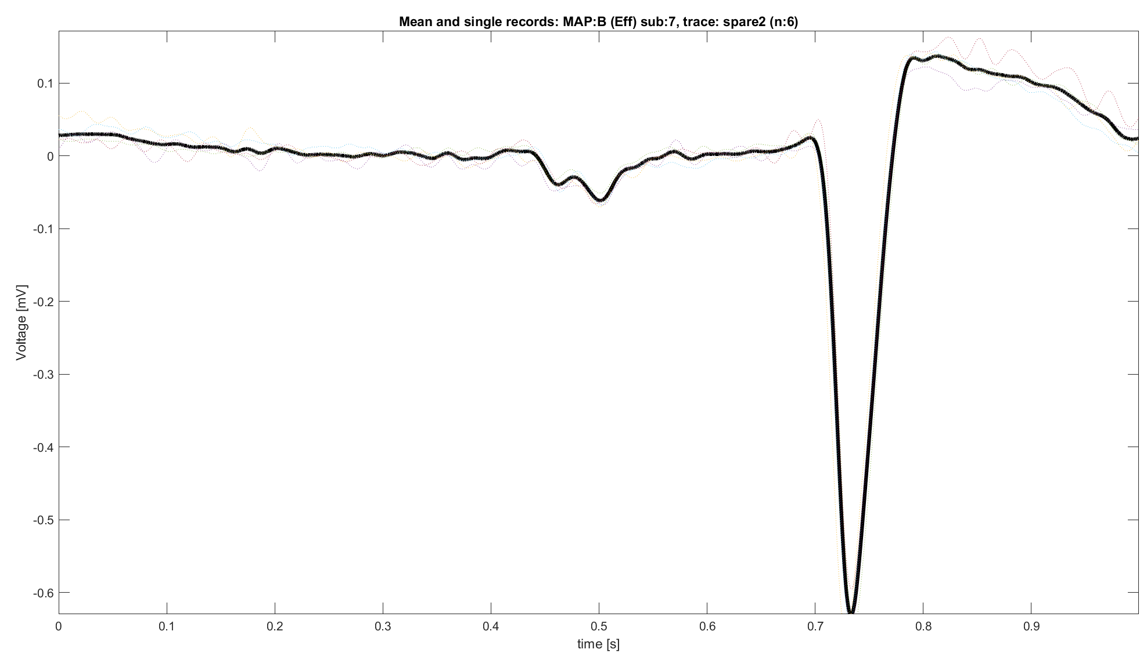
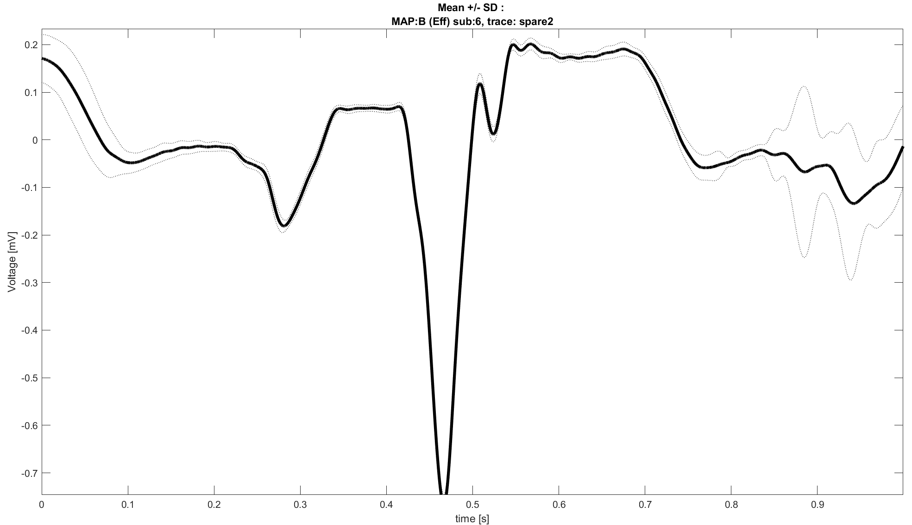
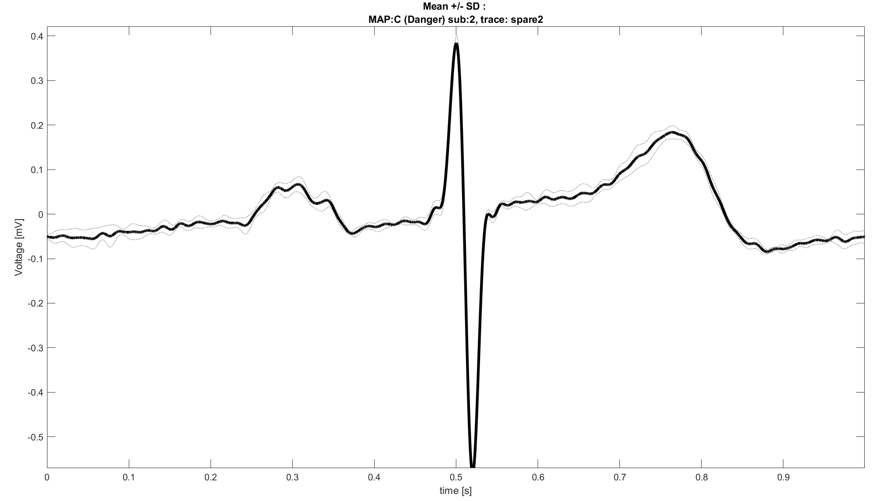
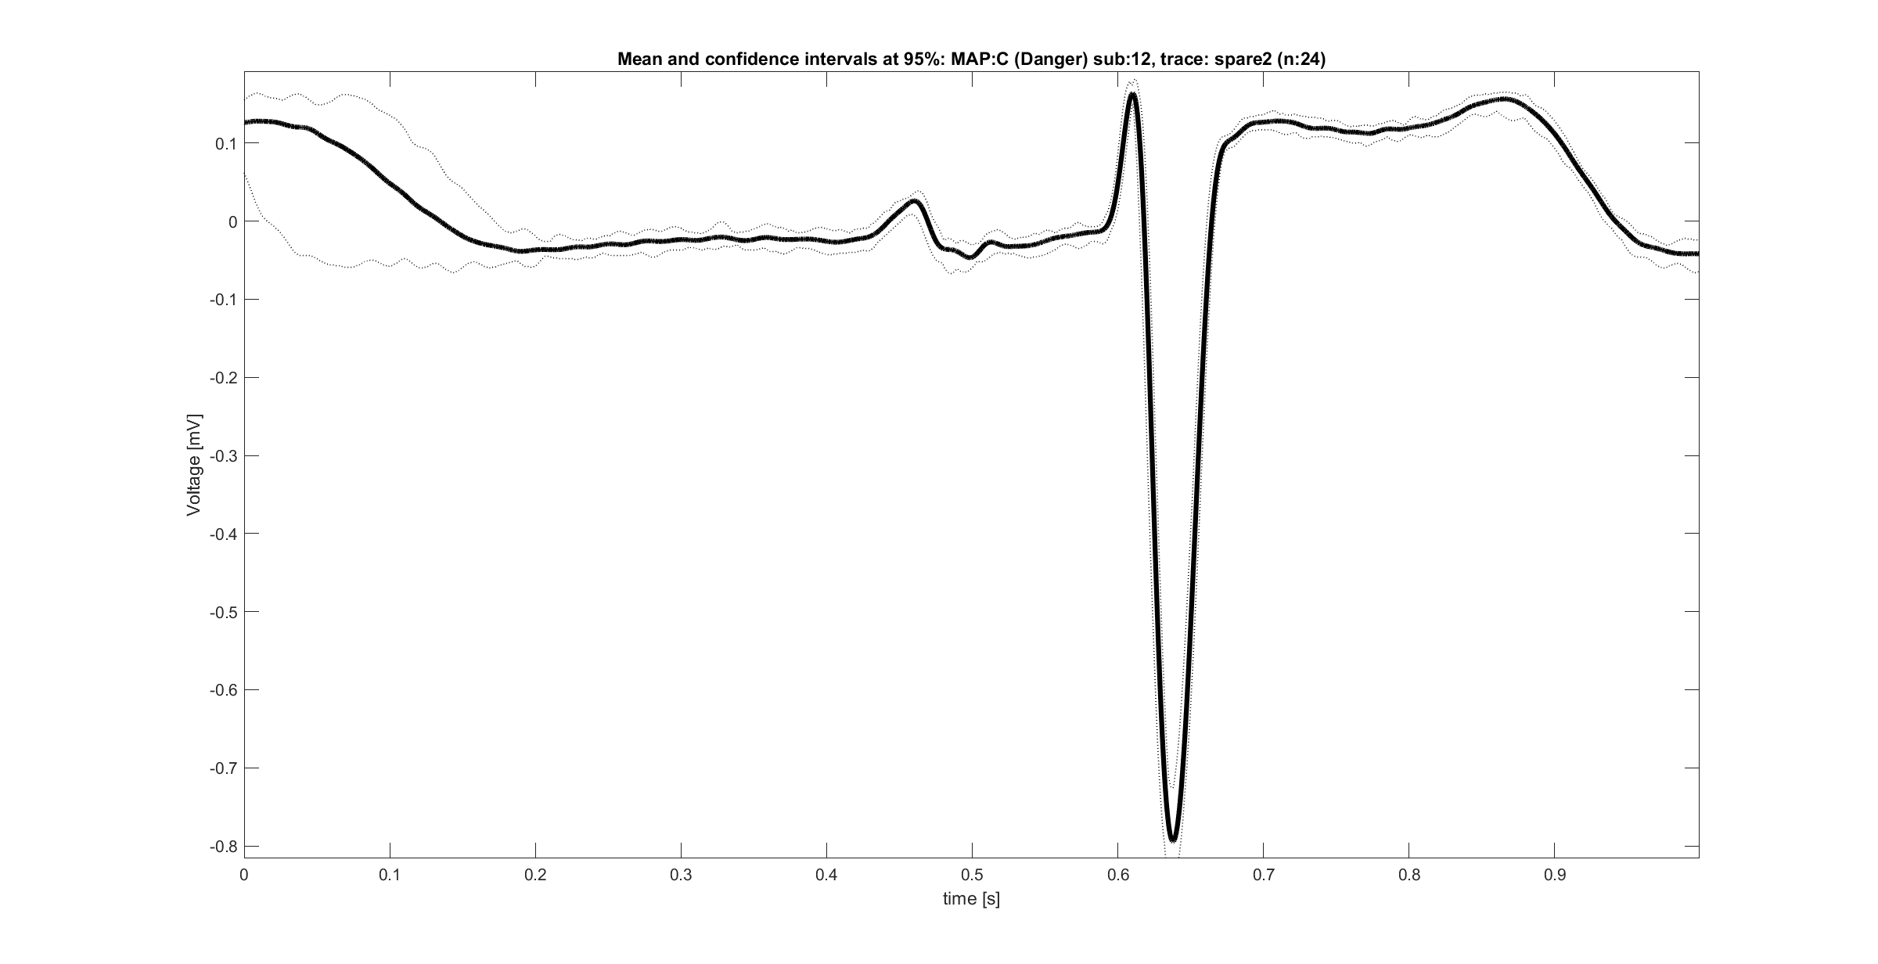
Understanding signals and their nature
Which are the ECG signals present into the AVNRT project database?
The answer is divided in two sub answers:
Ref trace
Spare traces
Spare Traces
Comparing ECG recordings [1,2,3] and the database traces it’s possible hypothesize that spare traces could be:
aVR, aVF, aVL
V1,V2,V3
NB: direct association (i.e., spare1 IS aVR) is hard, aspect that suggest a certain “freedom” in the definition of these traces, maybe connected with the clinician experience.
Ref traces
It’s possible that ref traces are one of:
CS signal
L1/aV signal
3. Manual of Medicine. (n.d.). Retrieved September 7, 2024, from https://manualofmedicine.com/

Slide 7
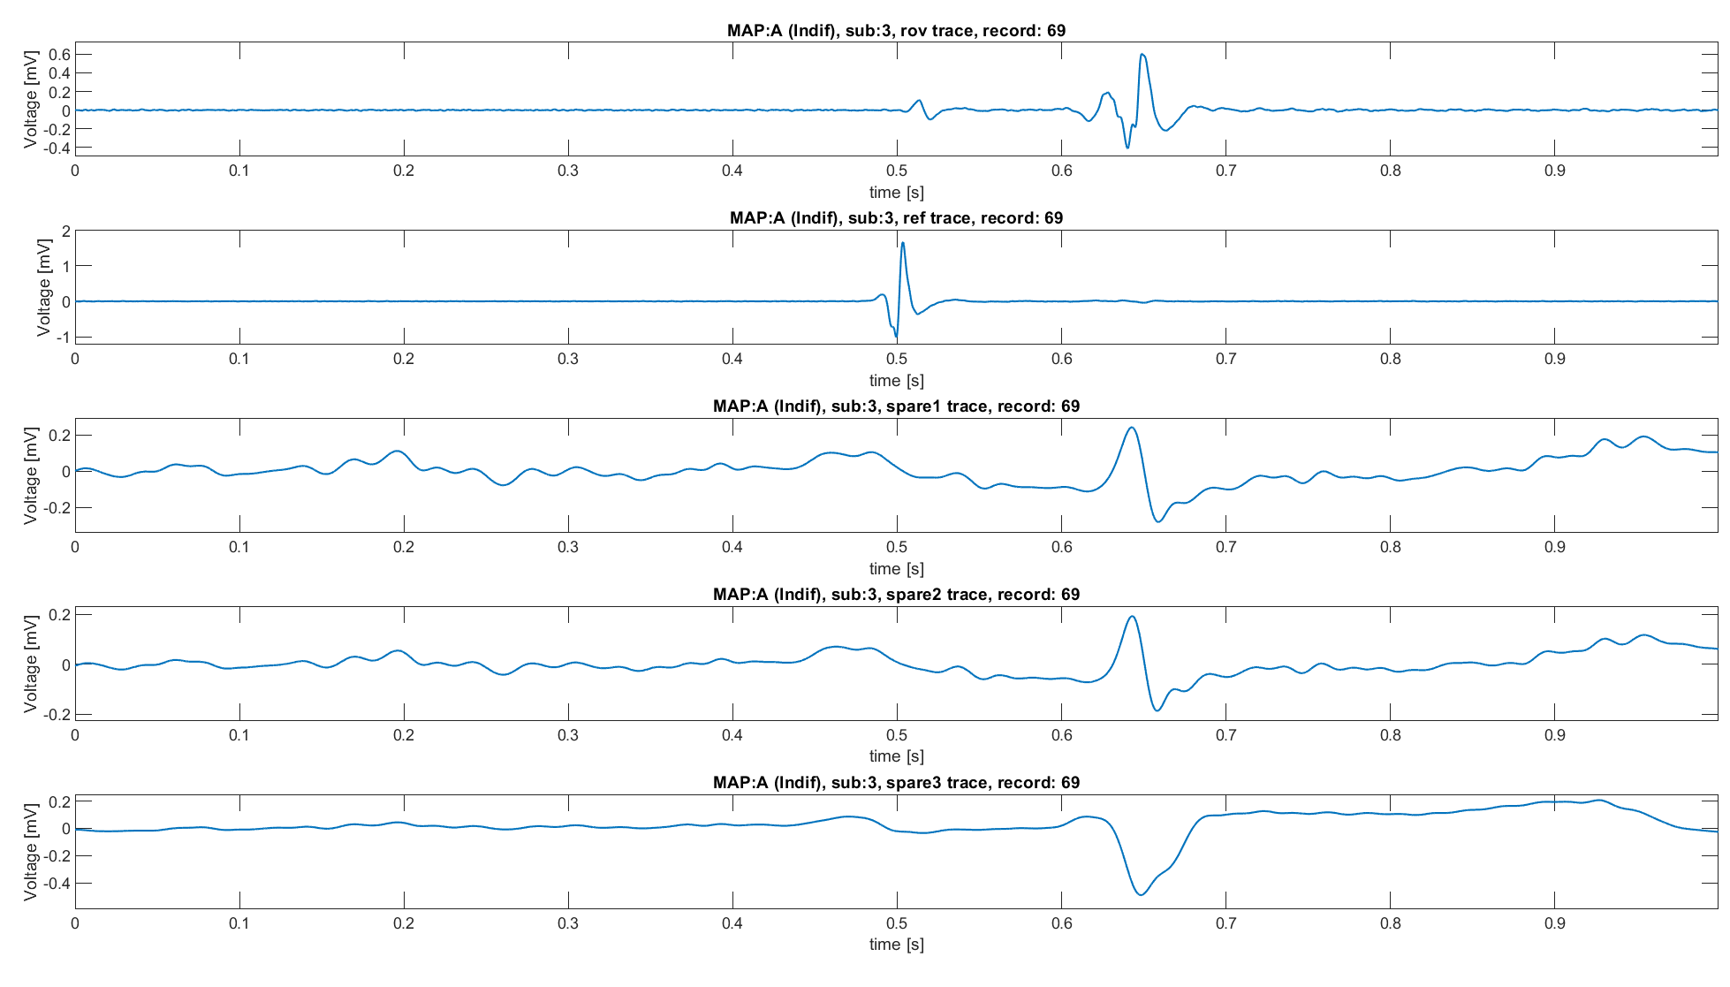
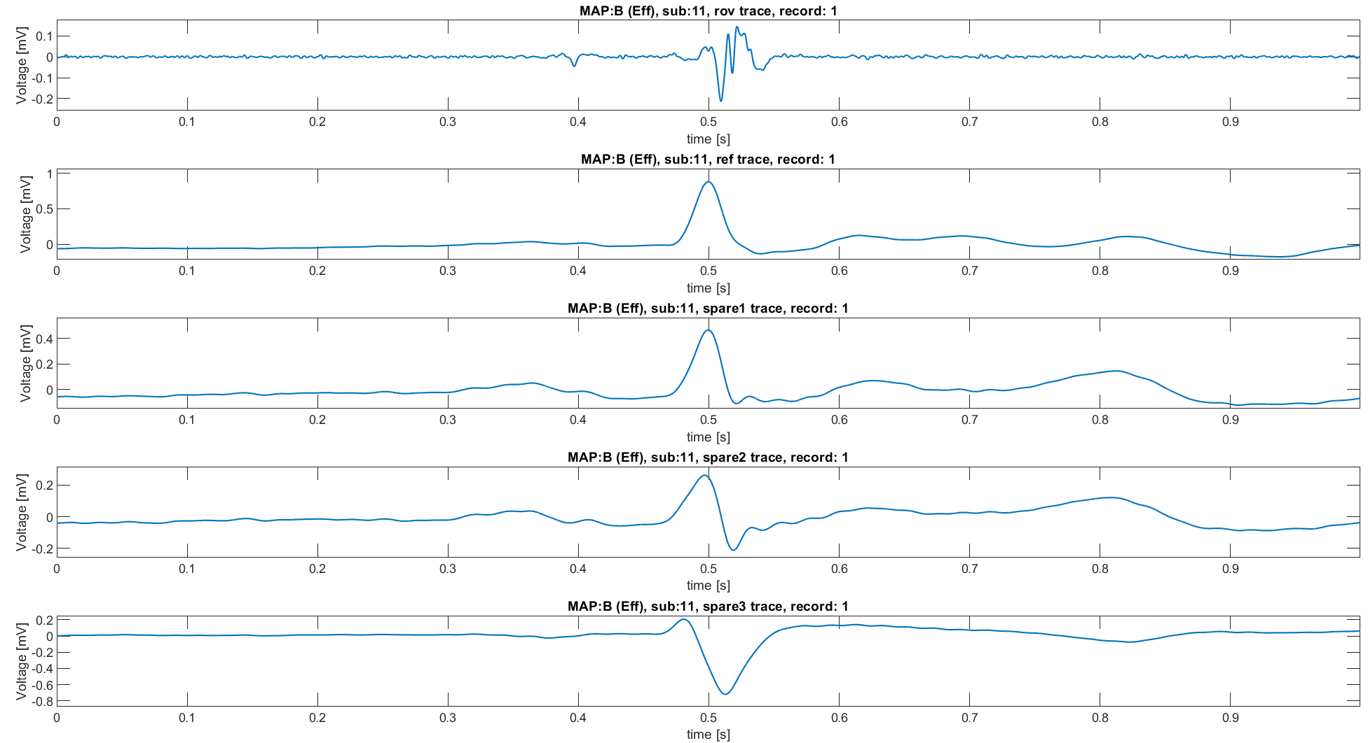
On the origin of Ref trace
The previous observation is supported not only by similarities with external examples, but even by the database signals themselves:
When Ref trace seems to be a CS signal, spare traces QRS are aligned, and P waves are aligned with the CS signal as expect. Thus, Rov trace is simply interpretable
When Ref trace seems to be a signal of another nature, QRS of ref trace and spare traces are aligned. Even in this case, Rov trace interpretation follows straightforward
In conclusion, whatever strategy of alignment should consider these observations.

Slide 8
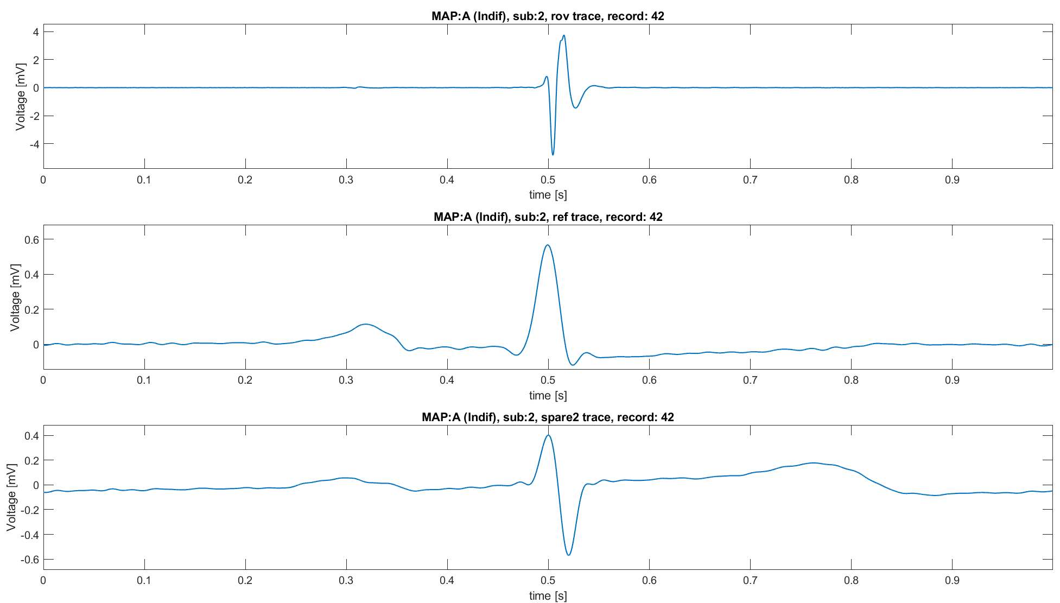
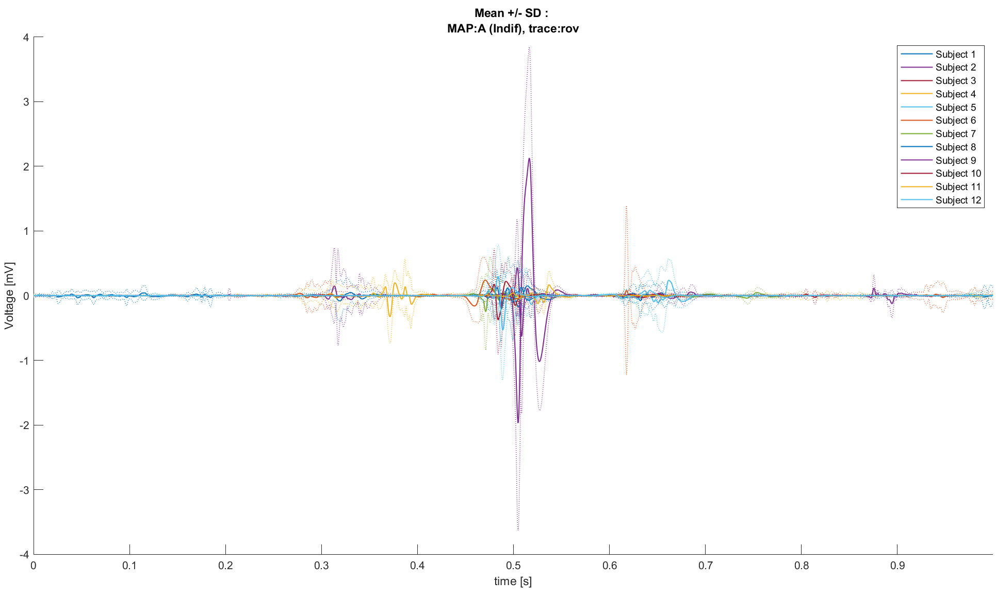
Necessity of Alignment
So far, we encountered several problems:
Distinguish between atrial and ventricular components into the ROV trace is not so easy
Traces are not directly comparable due to difference into the positions of the peaks
Population analysis isn’t possible in such situation
It’s necessary to find out a way to align traces
Key idea: align respect to QRS
Atrial
Ventricular
Atrial? Ventricular?
QRS

Slide 9
Pseudo-code strategy
To align Rov signals respect to the QRS the following strategy is used:
For each Rov signal
Find the QRS into another trace (i.e., ref or spare)
Define into the ROV trace a neighbourhood into which there is the QRS
Find the peak into the neighbourhood of the Rov trace
Align the QRS with the Rov peak using Nan-Padding and maintaining the original length of the signal.
QRS detection
Rov Neighborhood definition
Maximum into neighborhood localization
Peaks alignment
Base trace
Control trace

Slide 10
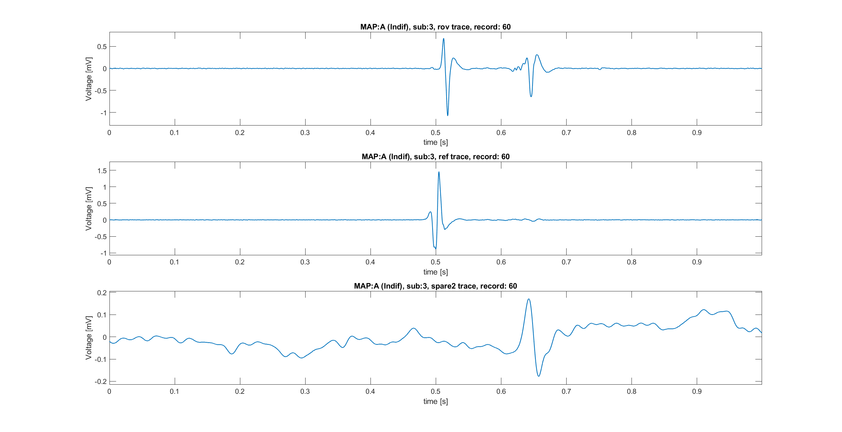
Base trace and control trace
To proceed with alignment, it’s necessary define respect which signal align the Rov trace. From now on we’ll use these names:
Base trace: trace respect to align the Rov trace
Control trace: trace used to define the neighbourhood into the Rov trace
The reason of such subdivision will be clear in the next slides.
Such division allow to build different strategies of alignment, explained into the next steps, here quickly summarized:
Strategy 1:
Base trace: ref trace
Control trace: ref trace
Strategy 2:
Base trace: ref trace
Control trace: spare2 trace
Strategy 3:
Base trace: spare1 trace
Control trace: spare2 trace
Base
Control

Slide 11
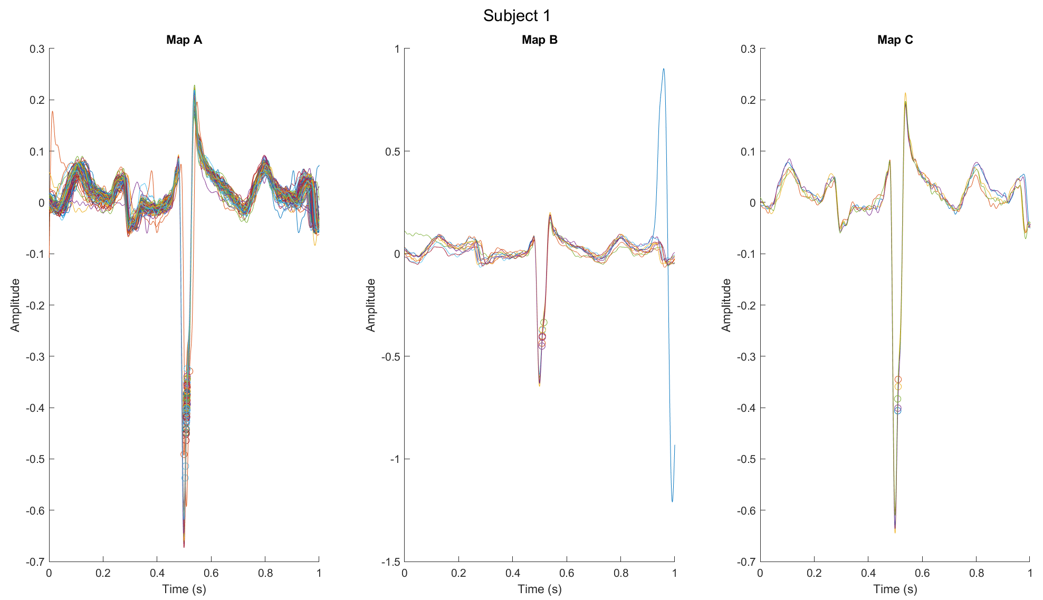
Pam-Tompkins algorithm
The Pan-Tompkins algorithm, (Willis J. Tompkins and Jiapu Pan, 1985) was designed to accurately detect QRS complexes in electrocardiogram (ECG) signals in real-time.
The algorithm works through a series of steps:
Bandpass Filtering: It filters the ECG signal to remove noise and baseline drift, focusing on the QRS complex frequency range (5-15 Hz).
Differentiation: The filtered signal is differentiated to highlight the high slopes of the QRS complex, which are its most distinctive feature.
Squaring: The differentiated signal is squared to accentuate the large values and suppress smaller ones, enhancing the QRS complex peaks.
Moving Window Integration: This step smooths the squared signal, producing a waveform that shows prominent peaks corresponding to the QRS complexes.
Thresholding: The integrated signal is then compared against a dynamic threshold to detect the precise QRS complex locations.
This algorithm is highly effective and has become a standard method for QRS detection due to its accuracy and relatively low computational complexity, making it suitable for real-time applications.

Slide 12
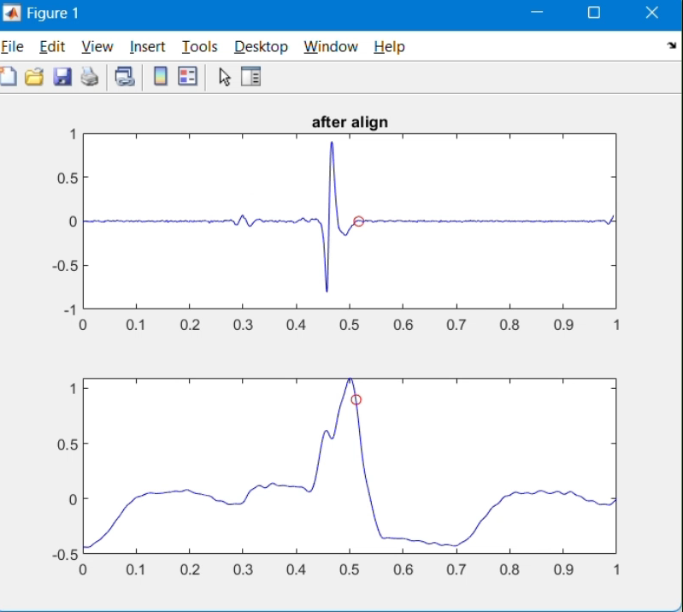
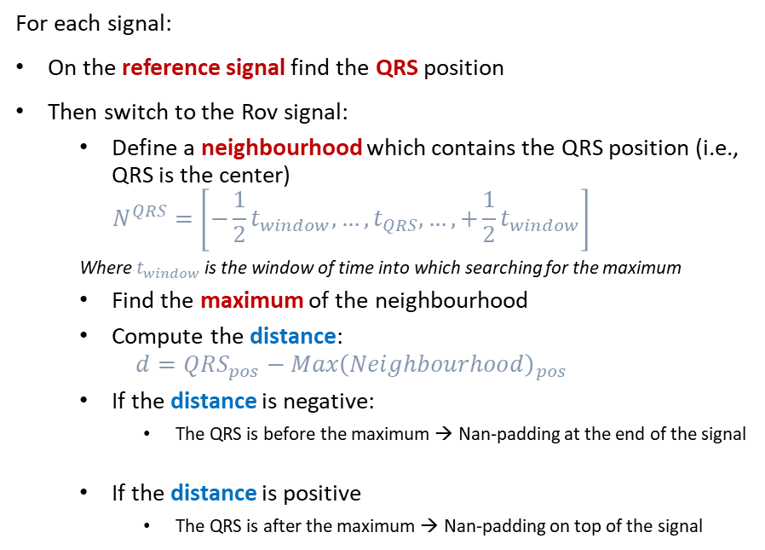
Traces alignment: strategy 1
Assumption: Ref trace has inside always all information about QRS position. Reference trace will act as base and control trace.
For each signal:
On the reference signal find the QRS position
Then switch to the Rov signal:
Define a neighbourhood which contains the QRS position (i.e., QRS is the center)
$$N^{QRS}=\left[−\frac{1}{2}t_{window},…,t_{QRS},…,+\frac{1}{2}t_{window}\right]$$
Where $t_{window}$ is the window of time into which searching for the maximum
Find the maximum of the neighbourhood
Compute the distance:
$$d=QRS_{pos}−Max{\left(Neighbourhood\right)}_{pos}$$
If the distance is negative:
The QRS is before the maximum → Nan-padding at the end of the signal
If the distance is positive
The QRS is after the maximum → Nan-padding on top of the signal
Hyperparameters
Time window: 0.01 s

Slide 13
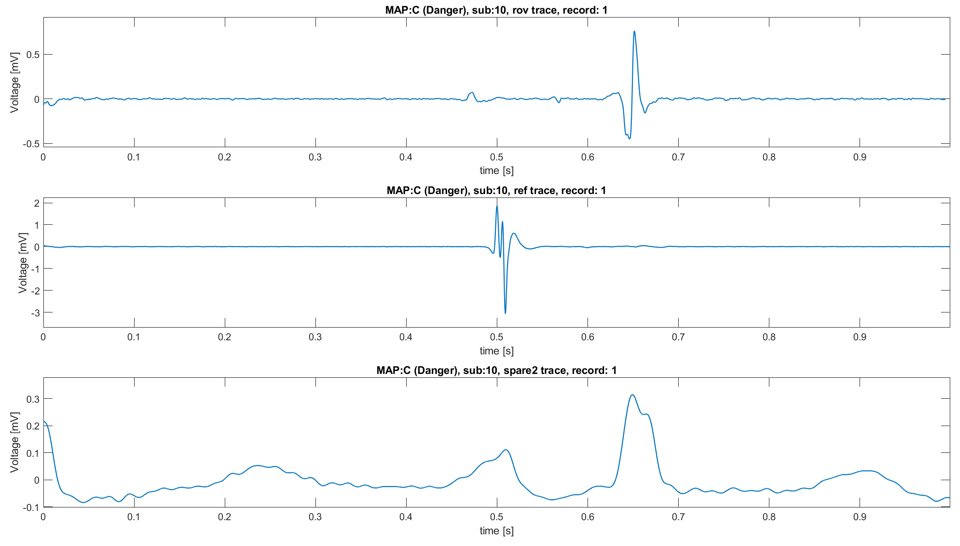
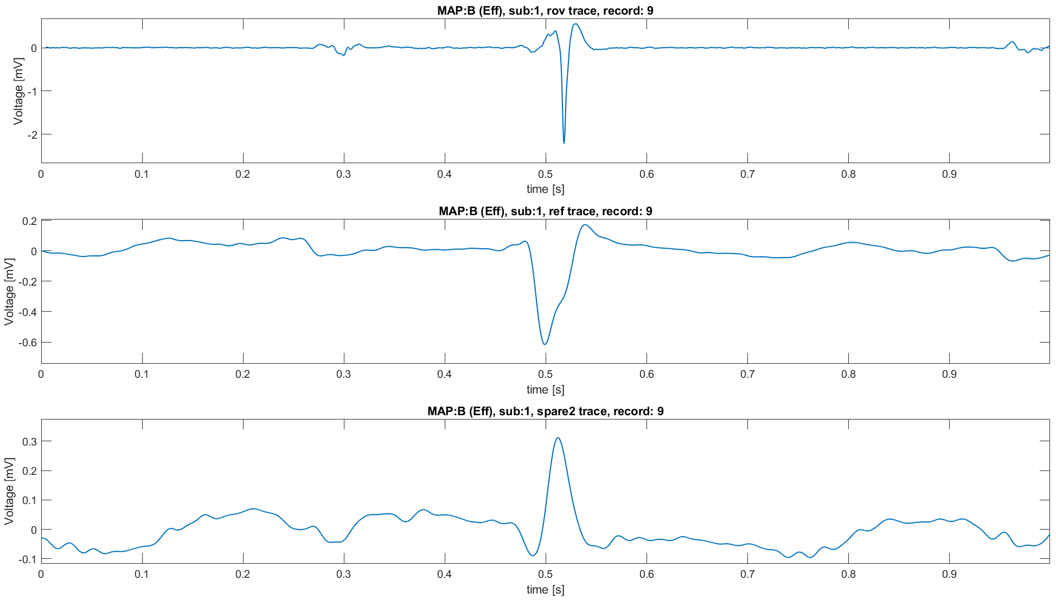
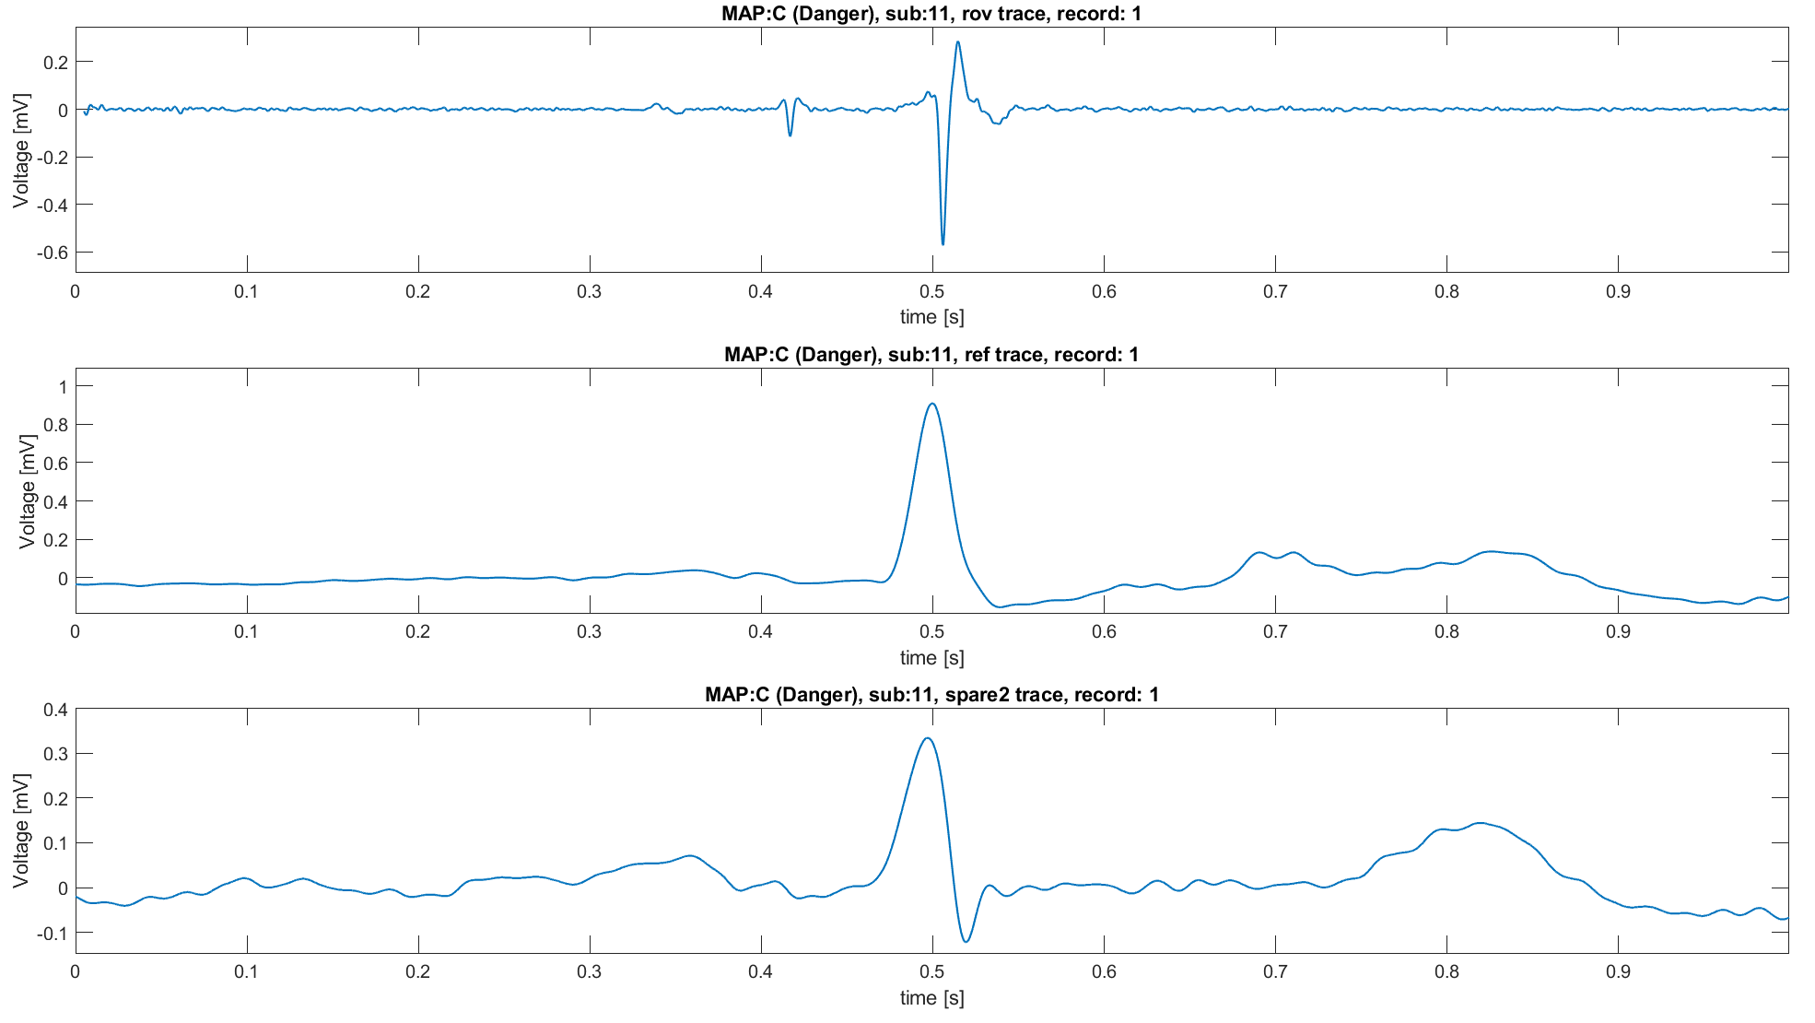
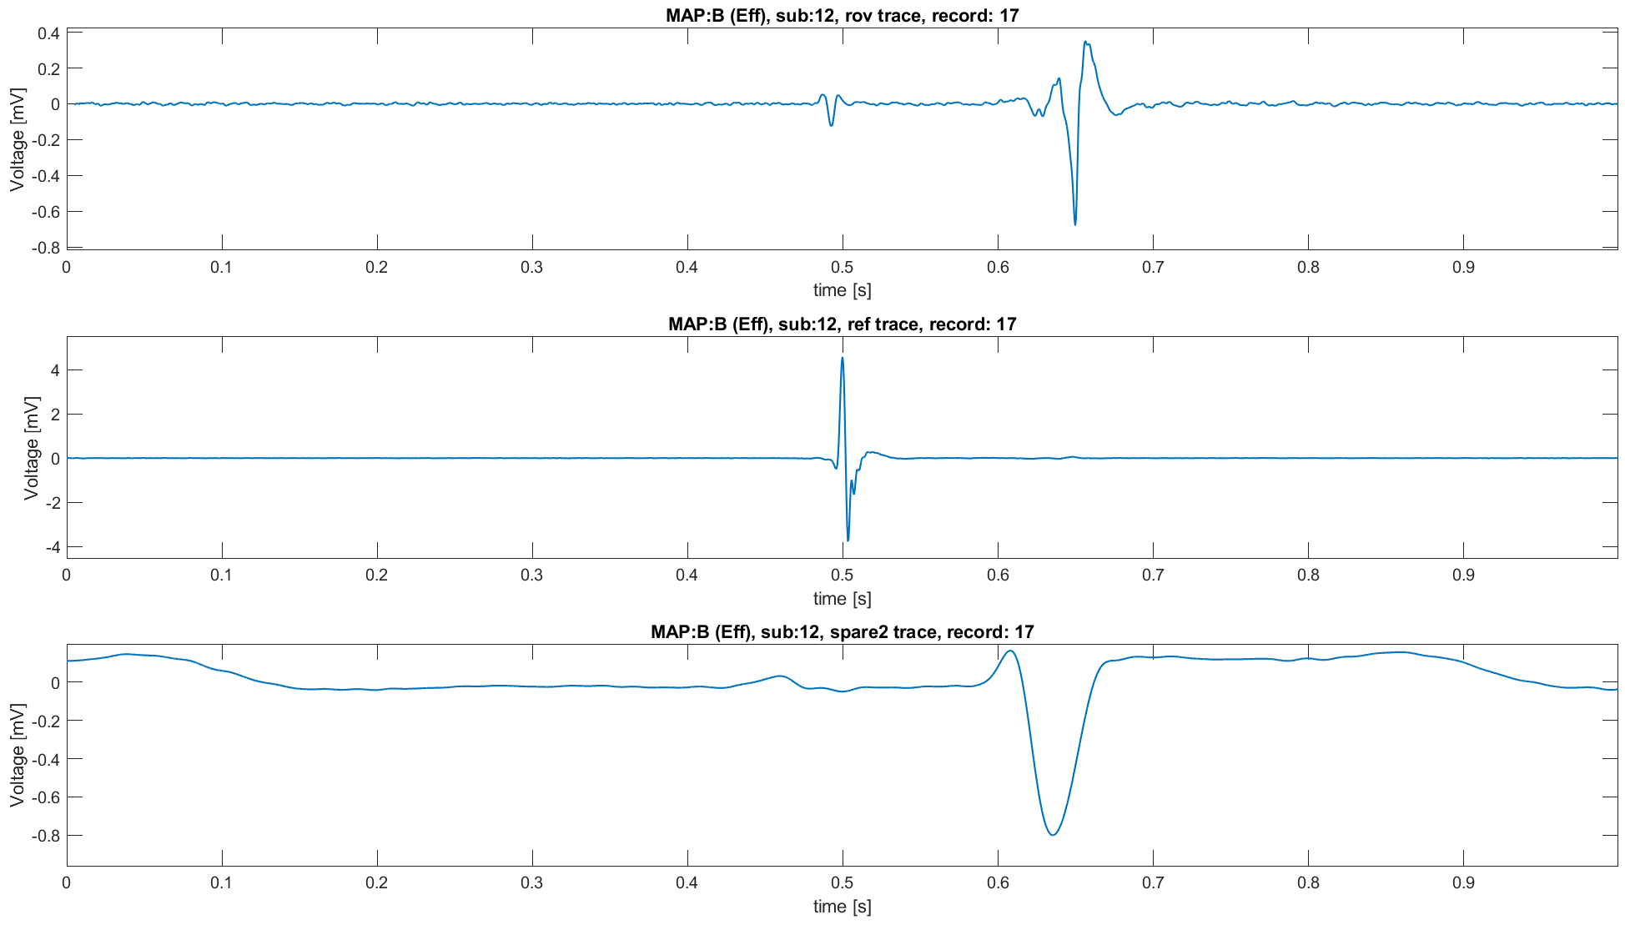
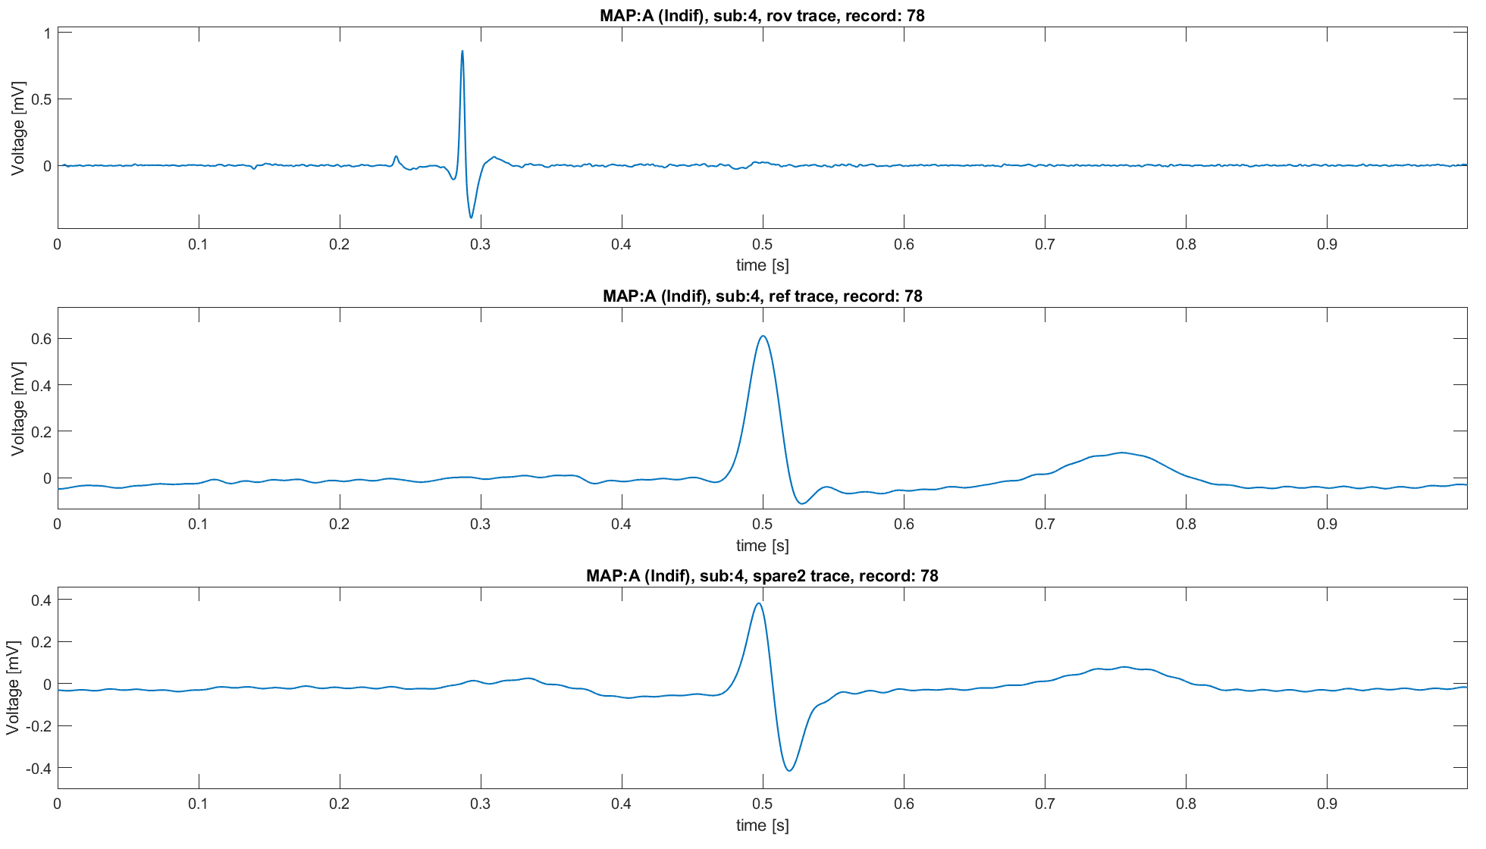
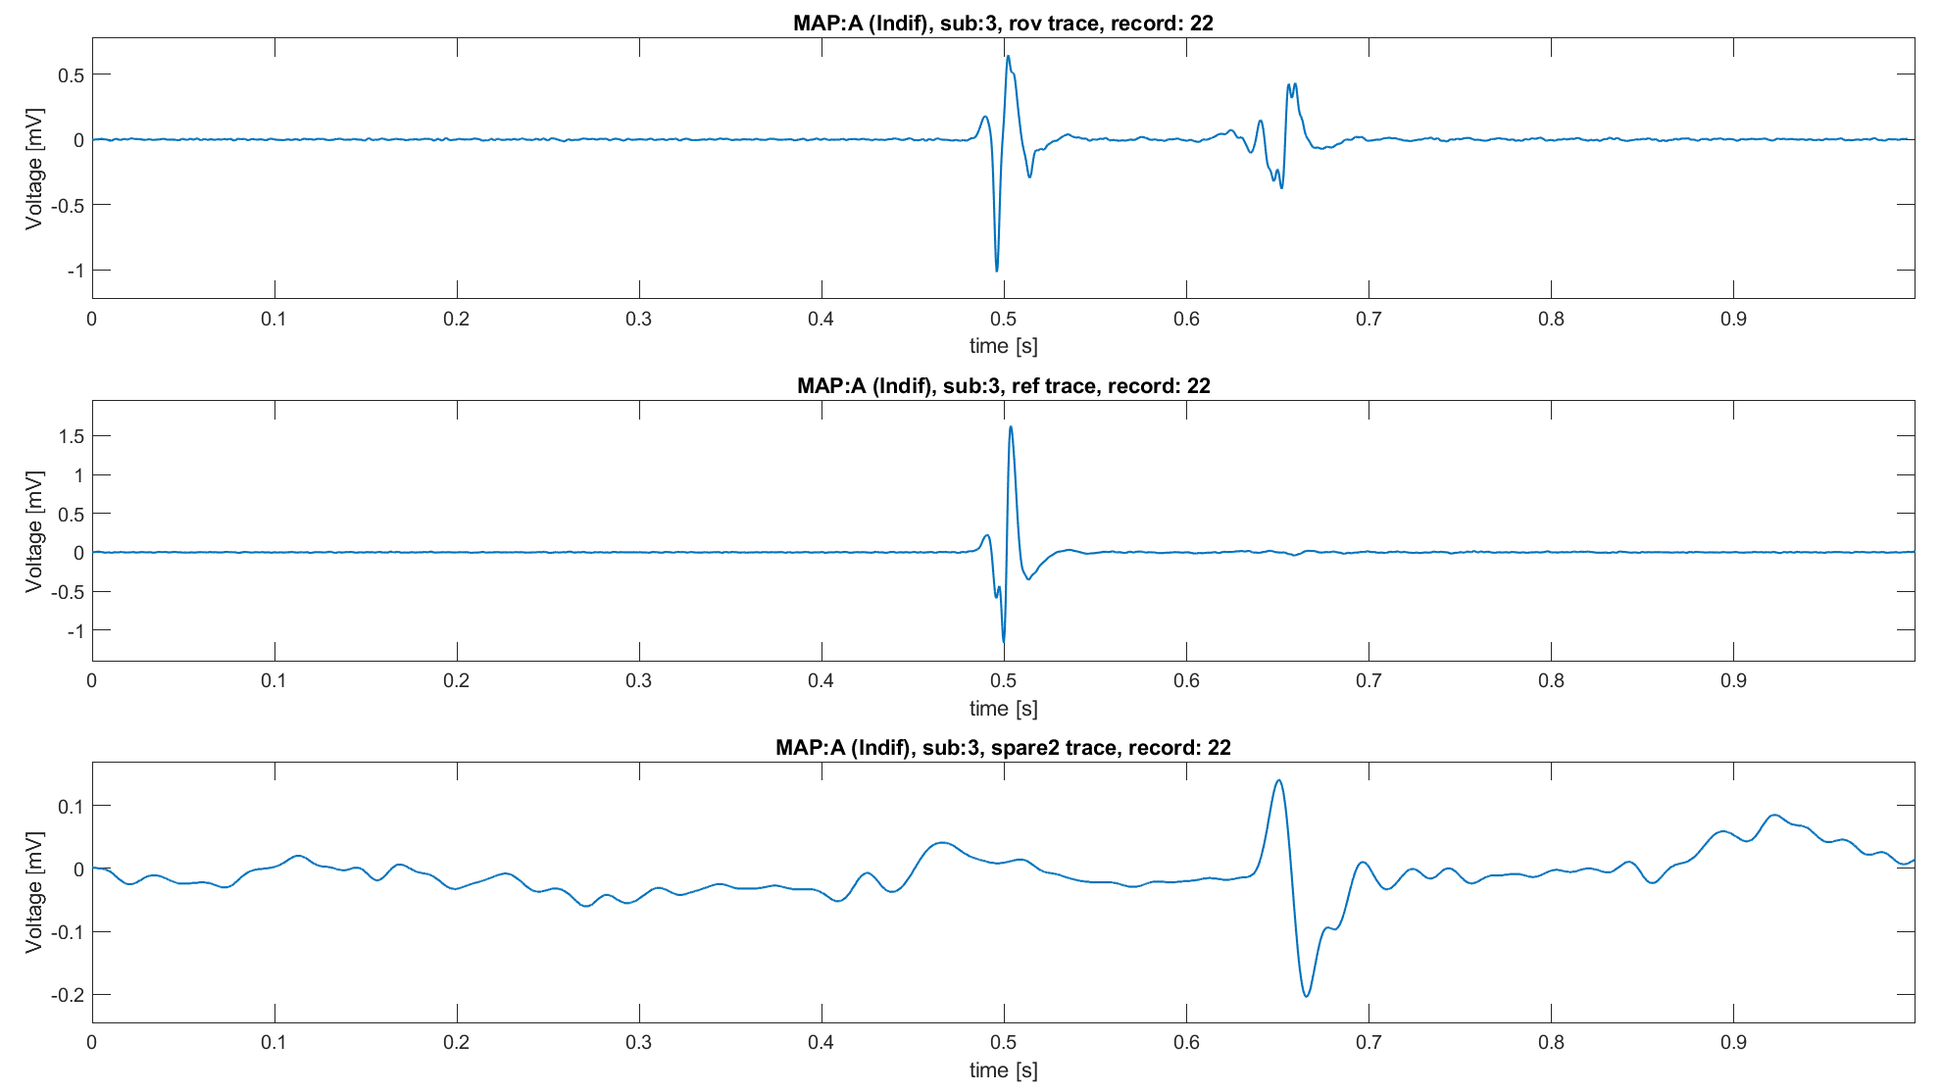
Strategy 1: results
For some traces results are encouraging.
Clear distinction between atrial and ventricular components (and His’ bundle)
Division of components in accordance with the expected characteristics of MAPs
In other cases, the results are misleading
Atrial signal aligned with the QRS, while the ventricular one not.
MAP C
MAP A
MAP B
MAP B
MAP A
MAP C

Slide 14
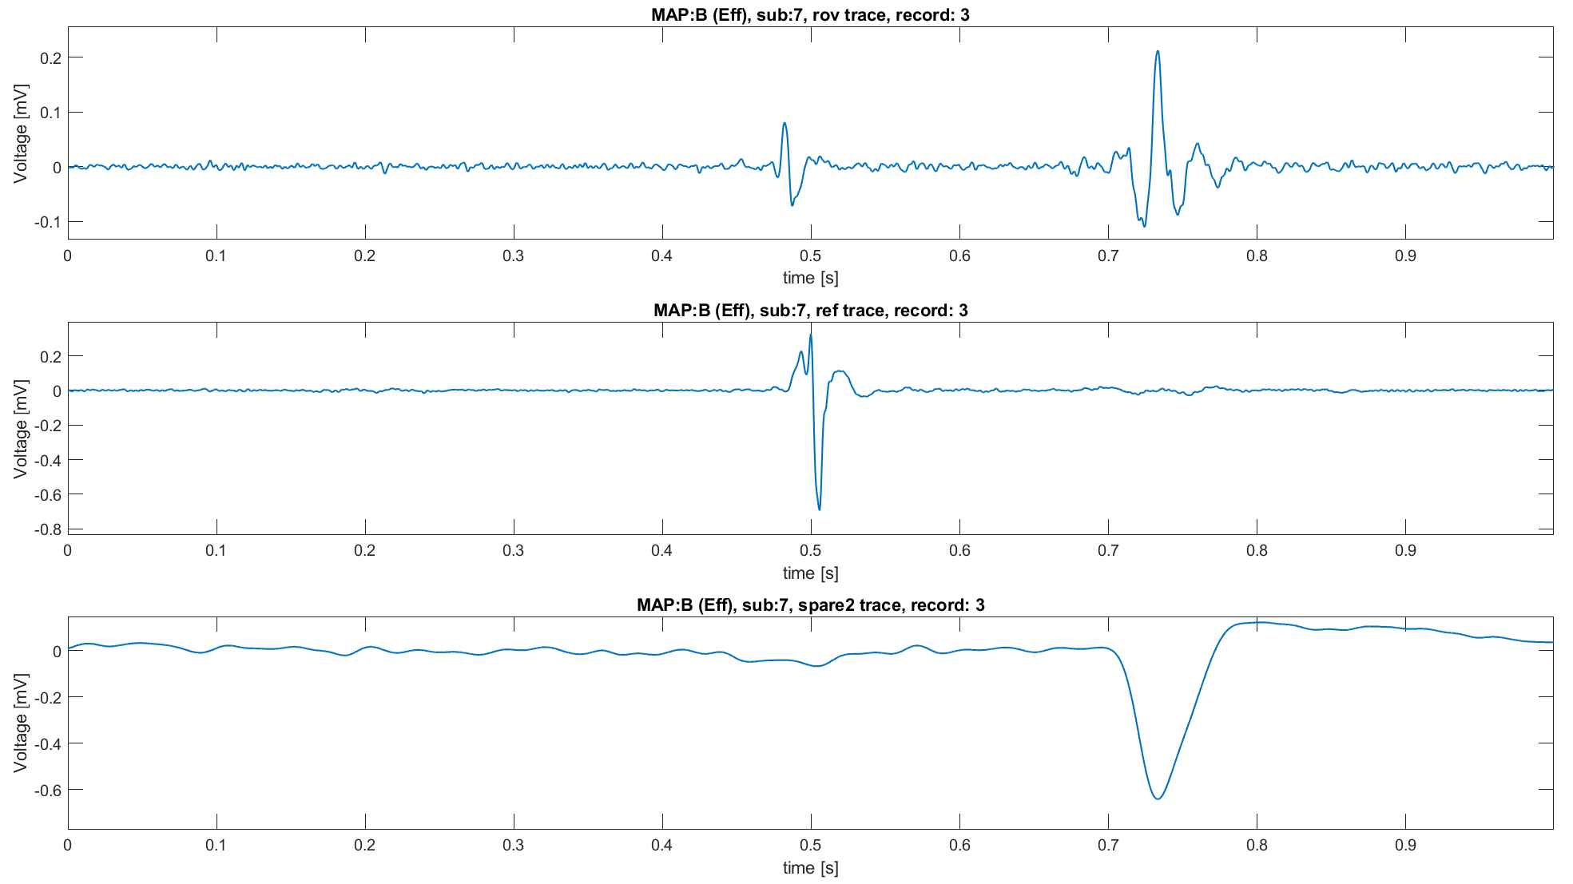
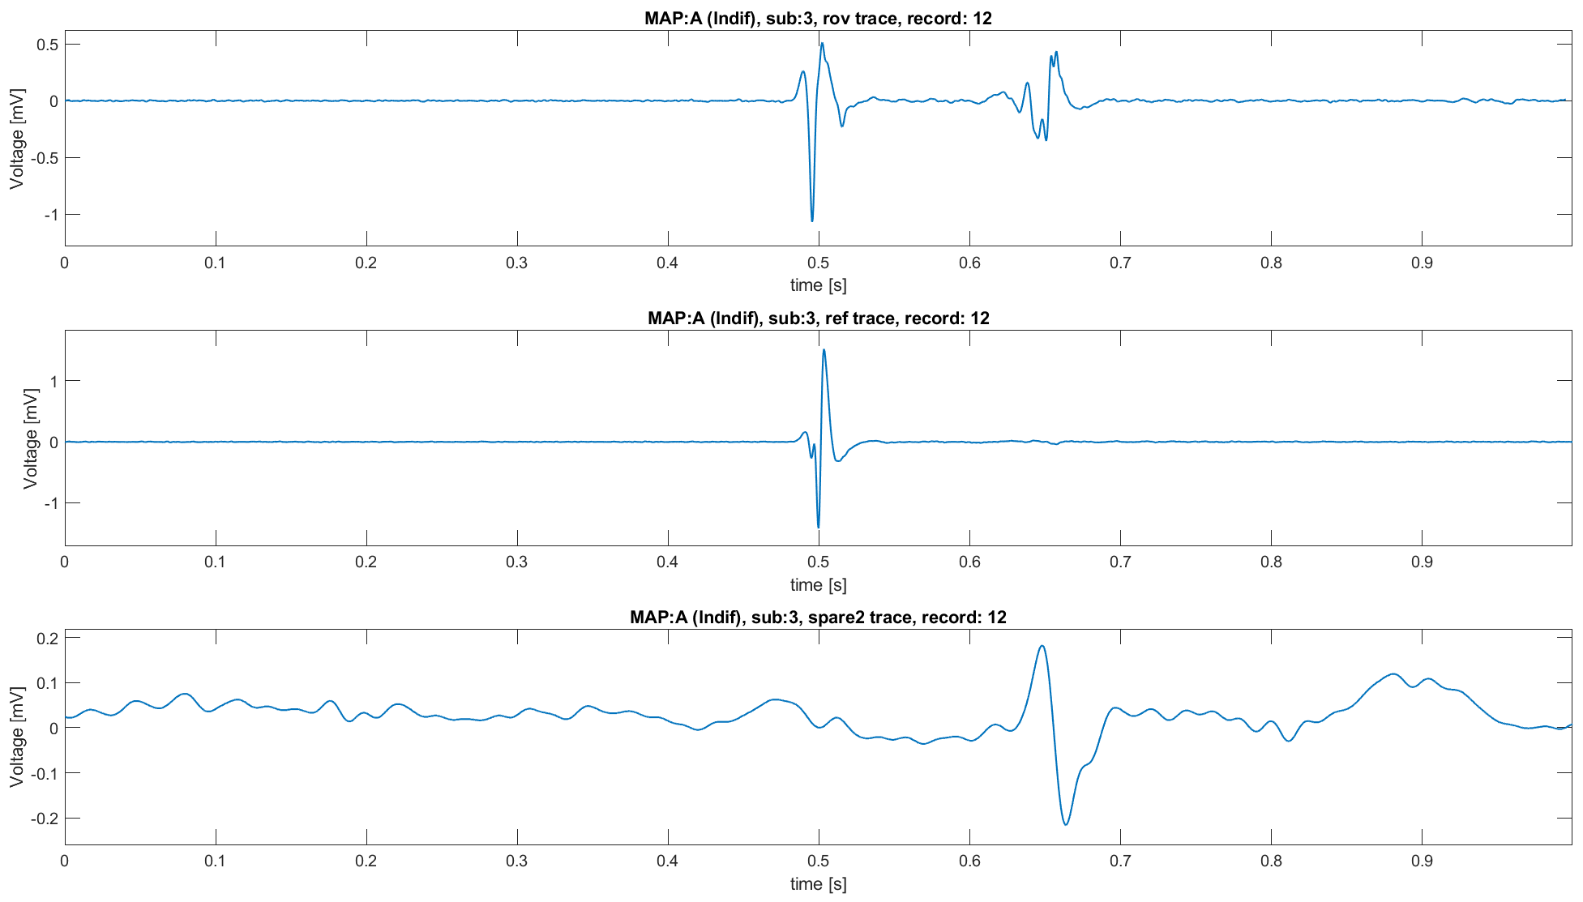
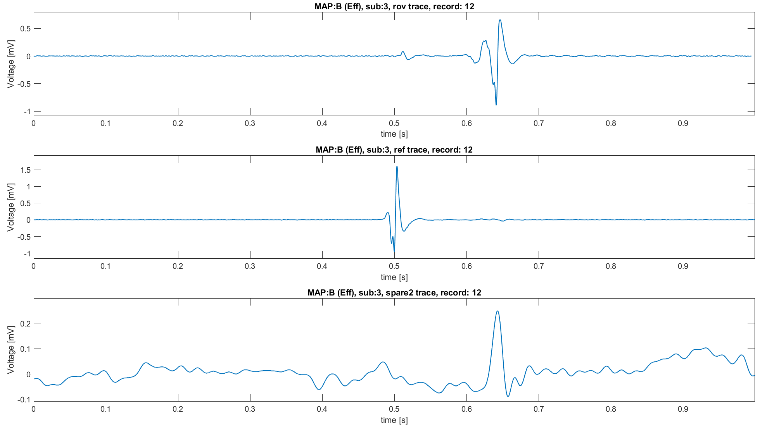
Strategy 1: understanding misleading results
Under the assumption that Rov trace has a QRS inside, it’s possible to deeper analyze the obtained results.
When the ROV signal is not correctly aligned, even the spare2 trace is not
Not correctly aligned
Not correctly aligned
Not correctly aligned
Correctly aligned
Correctly aligned
Correctly aligned

Slide 15




Traces alignment: strategy 2
Assumption: Ref trace has inside the QRS position, which could be misaligned respect to the QRS of spare2 trace. So spare traces and Ref traces refers to a Ventricular contraction.
Reference trace is the base trace, spare 2 is the control trace.
For each signal:
Find the QRS position on the reference signal and on the spare 2 one.
Then switch to the Rov signal:
Evaluate the time delay between the QRS position into Ref and spare 2 trace.
If the Delay is more than a certain $tolerance$:
QRS points are not close in time → center the neighbourhood around the QRS of the spare 2 trace
If the Delay is lower than a certain $tolerance$:
QRS into spare 2 trace is near the QRS into the reference trace → center the neighbourhood around the QRS of the reference
Define a neighbourhood which contains the QRS position (i.e., QRS is the center)
$$N^{QRS}=\left[−\frac{1}{2}t_{window},…,t_{central},…,+\frac{1}{2}t_{window}\right]$$
Where $t_{window}$ is the window of time into which searching for the maximum
Find the maximum of the neighbourhood
Compute the distance:
$$d=QRS_{pos}−Max{\left(Neighbourhood\right)}_{pos}$$
If the distance is negative:
The QRS is before the maximum → Nan-padding at the end of the signal
If the distance is positive
The QRS is after the maximum → Nan-padding on top of the signal
$$As done before$$
$$t_{central} positioning$$
Hyperparameters
Time window: 0.01 s
Tolerance: 0.05 s
Notes:
the possibility of having multiple QRS detected is handle considering the most prominent one
Unvaluable QRS points are imputed using the median QRS position for the trace

Slide 16
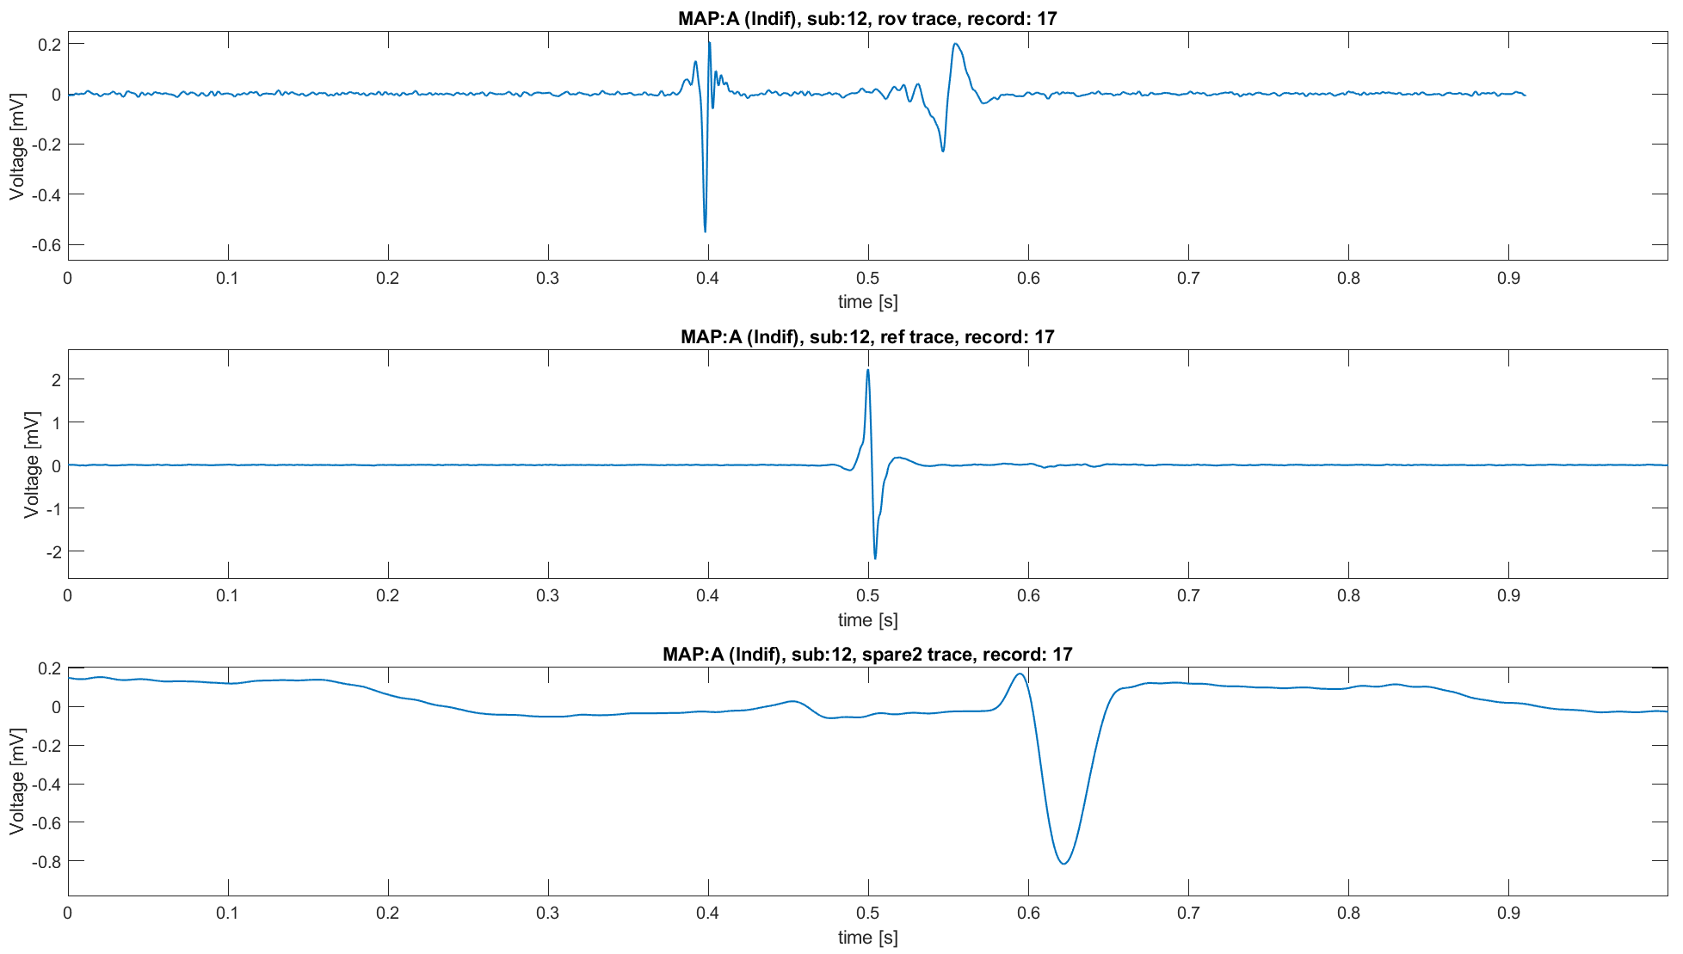
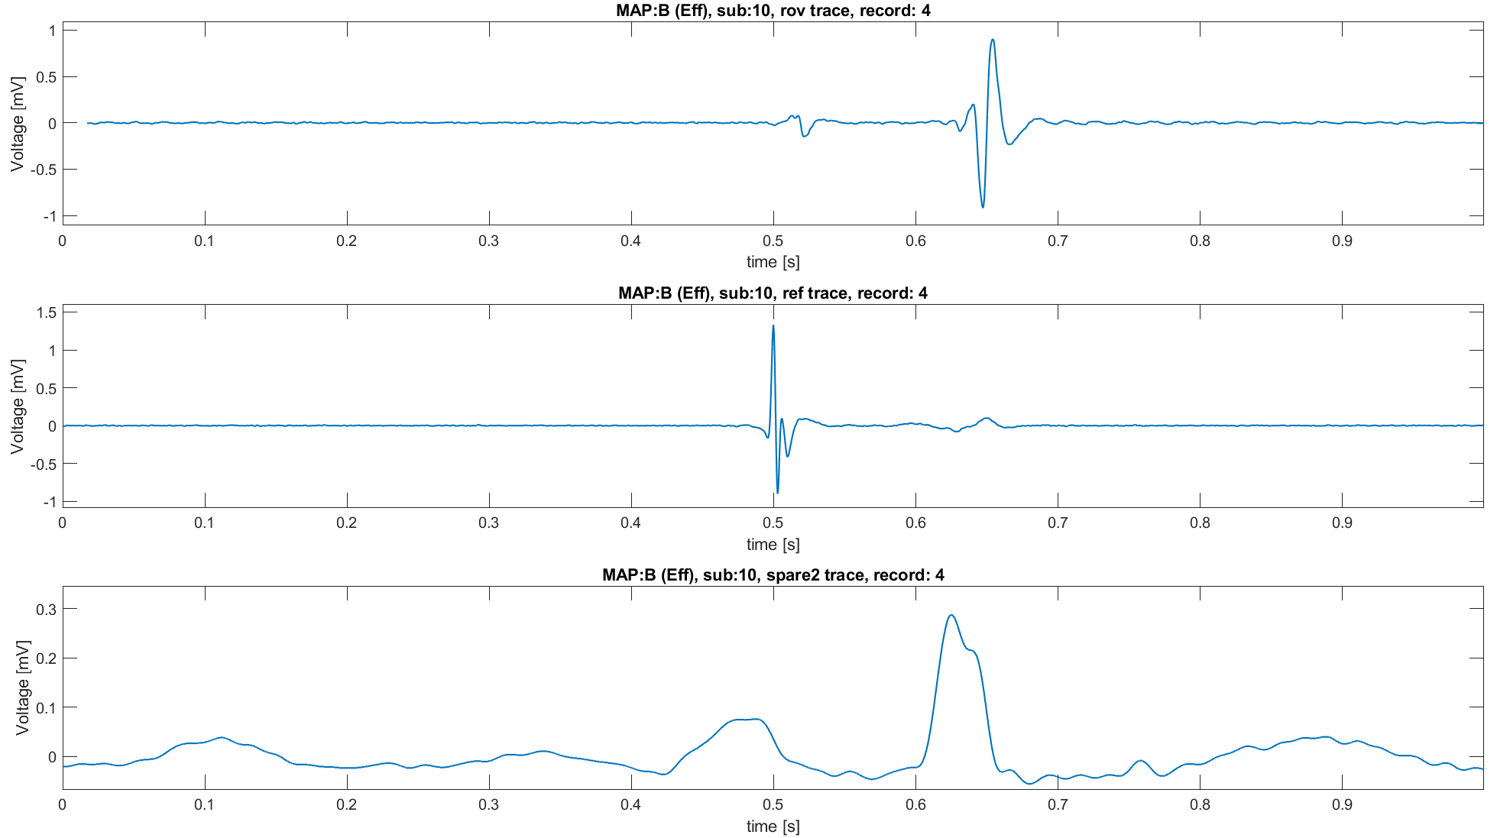
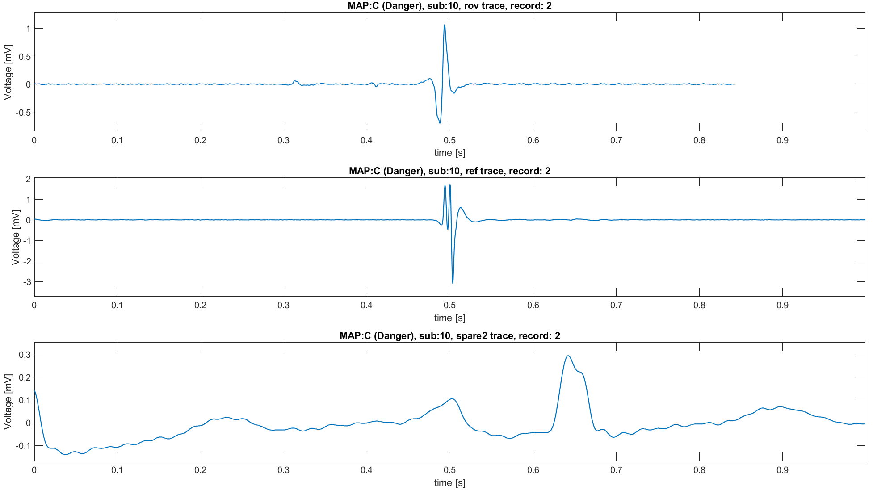
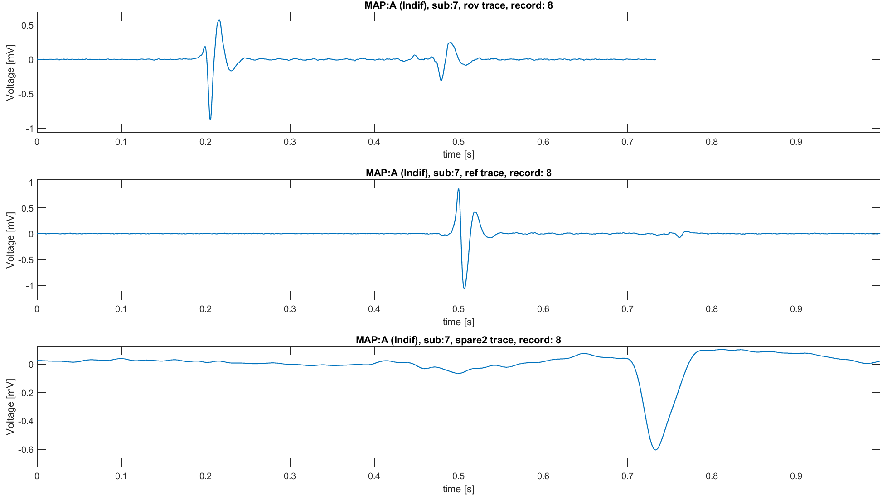
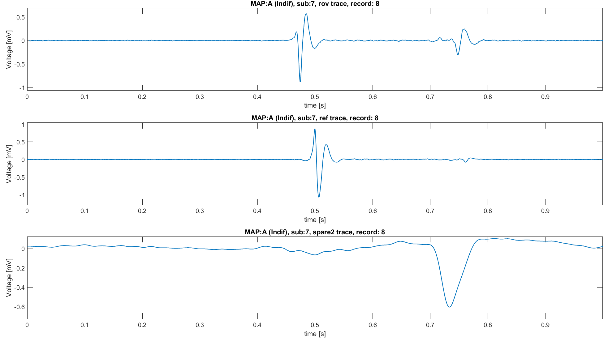
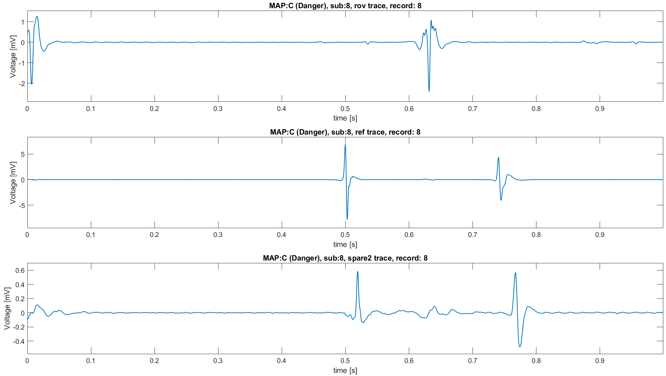
Strategy 2: results
Results correctly obtained with strategy 1 are maintained.
But now errors are corrected.
Clear distinction between atrial and ventricular components (and His’ bundle) even in signals with spare traces not aligned respect to the reference
Even with signals with multiple QRS episodes
Even if not always
Due to limits of the QRS-detection algorithm. (i.e., low flexibility of hyperparameters)
A visual inspection suggest less than 1.5% of signals bad aligned
Strategy 2
Strategy 2
Strategy 2
Strategy 2
Strategy 1

Slide 17

Traces alignment: strategy 3
Assumption: Ref trace hasn’t aways inside the QRS, which is always present into spare 1 and spare 2 traces. In other words, Ref trace could be the CS signal.
Spare 1 is the base trace, spare 2 is the control trace.
For each signal:
Find the QRS position on the spare 1 and on the spare 2 one.
Then switch to the Rov signal:
Evaluate the time delay between the QRS position into spare 1 and spare 2 trace.
If the Delay is more than a certain $tolerance$:
QRS points are not close in time → center the neighbourhood around the QRS of the spare 2 trace
If the Delay is lower than a certain $tolerance$:
QRS into spare 2 trace is near the QRS into the reference trace → center the neighbourhood around the QRS of the spare 1
Define a neighbourhood which contains the QRS position (i.e., QRS is the center)
$$N^{QRS}=\left[−\frac{1}{2}t_{window},…,t_{central},…,+\frac{1}{2}t_{window}\right]$$
Where $t_{window}$ is the window of time into which searching for the maximum
Find the maximum of the neighbourhood
Compute the distance:
$$d=QRS_{pos}−Max{\left(Neighbourhood\right)}_{pos}$$
If the distance is negative:
The QRS is before the maximum → Nan-padding at the end of the signal
If the distance is positive
The QRS is after the maximum → Nan-padding on top of the signal
$$As done before$$
$$t_{central} positioning$$
Hyperparameters
Time window: 0.01 s
Tolerance: 0.05 s
Notes:
the possibility of having multiple QRS detected is handle considering the most prominent one
Unvaluable QRS points are imputed using the median QRS position for the trace

Slide 18
Strategy 2: results
Results correctly obtained with strategy 1 are maintained.
But now errors are corrected.
Clear distinction between atrial and ventricular components (and His’ bundle) even in signals with spare traces not aligned respect to the reference
Even with signals with multiple QRS episodes
Even if not always
Due to limits of the QRS-detection algorithm. (i.e., low flexibility of hyperparameters)
A visual inspection suggest less than 1.5% of signals bad aligned
Strategy 2
Strategy 2
Strategy 2
Strategy 2
Strategy 1

Slide 19
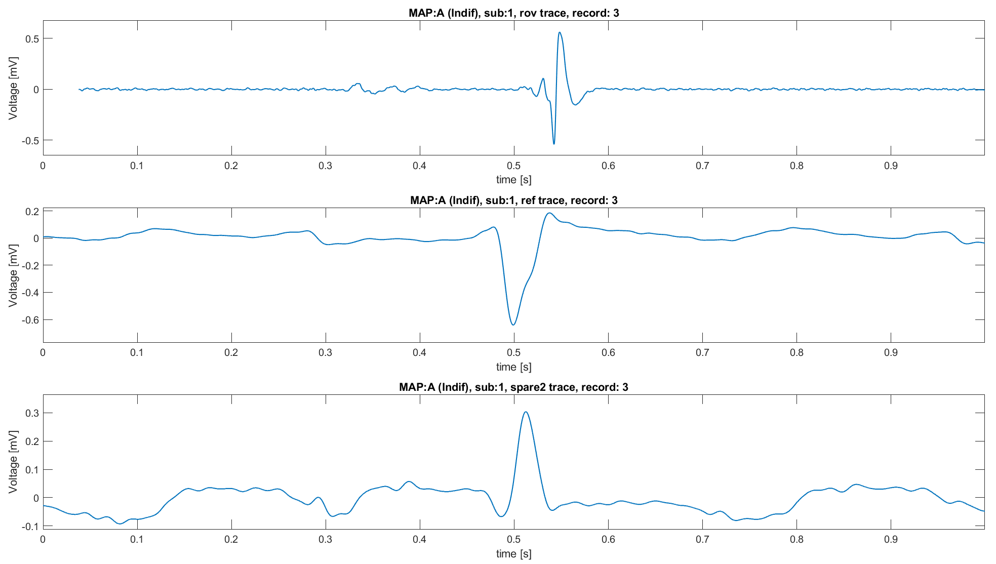
Further comments and observations
After the alignment it’s possible to clearly distinguish between atrial and ventricular contributions.
Thus, it’s possible to check the Maps’ proprieties.
By looking at the signals after the alignment there is still an open question:
Why some traces have a dominant component which is not expected?
Example: dominant ventricular signal into a record from MAP A
Possible answers:
Wrong strategy of alignment
Noise and bad positioning of the electrode
Necessity of positional information to completely characterize the signal (i.e., the heart surgeon knows where it’s located with the electrode and uses this information to “classify” the signal)
Since the classification is done a posteriori (knowing the ablation result), it is possible that the signal may be afferent to a certain MAP even though its characteristics do not suggest the classification assigned to it
Why?

Slide 20
Conclusions
The presented analysis starts by highlighting the necessity of signal alignment
The first strategy used was too simple and leads to misleading results
The second one considers even of the spare signals, leading to more robust and reliable results. Even in this case some errors can occur but are very limited (less than 1.5% of signals). Probably, a more flexible and adaptable algorithm could improve the overall quality of the alignment
Finally, an analysis of the information lost due to Nan-Padding should be done:
On average, each subject lost 10% of each signal record (around 200 points per signal)
But such average has high standard deviation: around 7% (maximum average information lost: 15%, lowest: 0.3%)

Slide 21
References
Katritsis, D. G., & Camm, A. J. (2010). Atrioventricular nodal reentrant tachycardia. Circulation, 122(8), 831-840.
Hafeez Y, Armstrong TJ. Atrioventricular Nodal Reentry Tachycardia. 2023 Aug 7. In: StatPearls [Internet]. Treasure Island (FL): StatPearls Publishing; 2024 Jan
Manual of Medicine. (n.d.). Retrieved September 7, 2024, from https://manualofmedicine.com/
Budzikowski, Adam S., et al. "How to perform cryoablation for atrioventricular nodal reentrant tachycardia." Cardiology Journal 14.6 (2007): 597-604.

